Slide 1

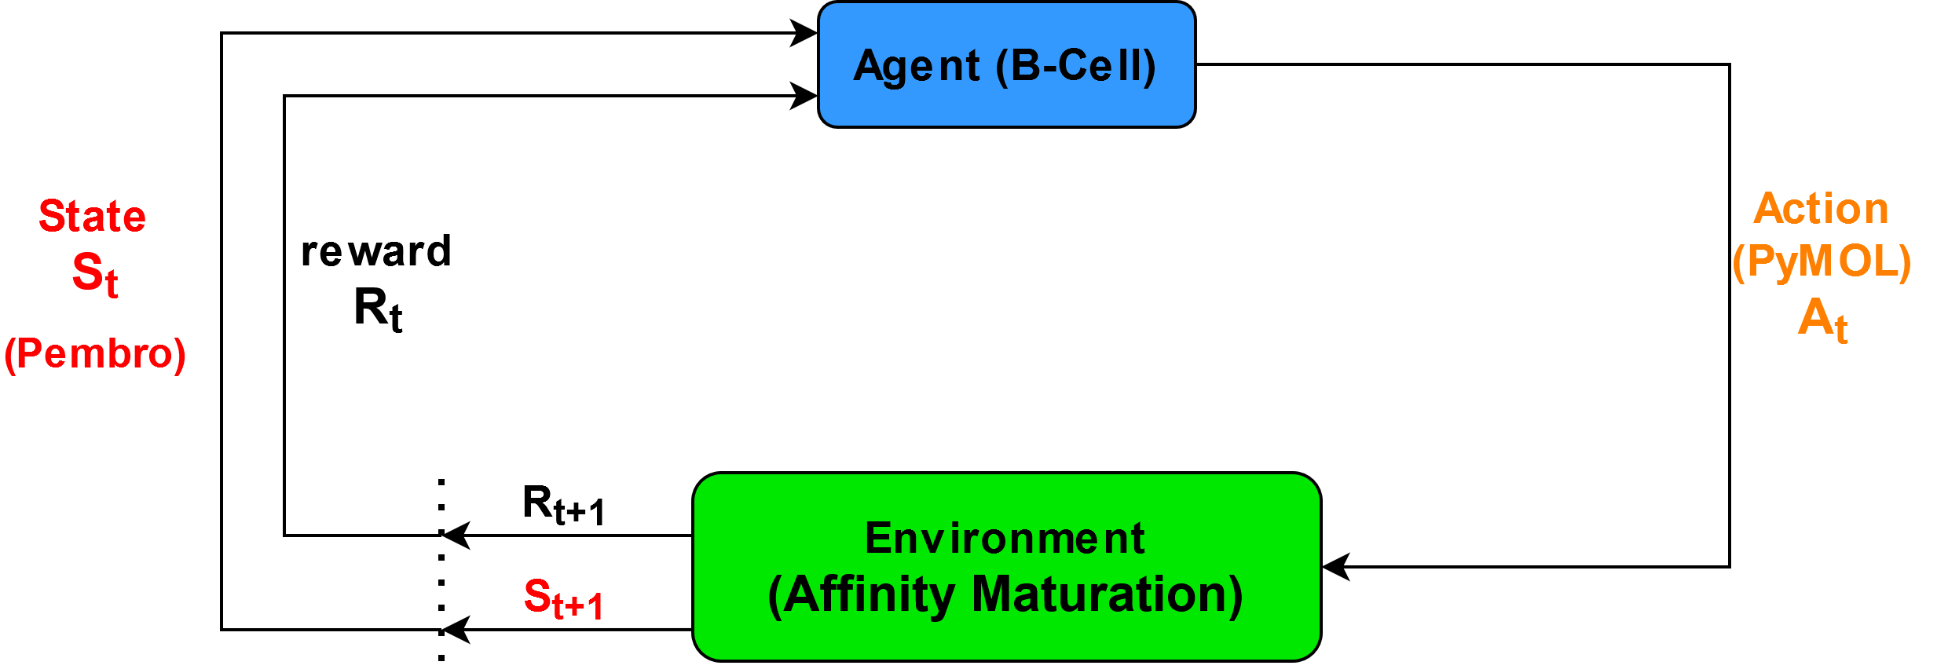

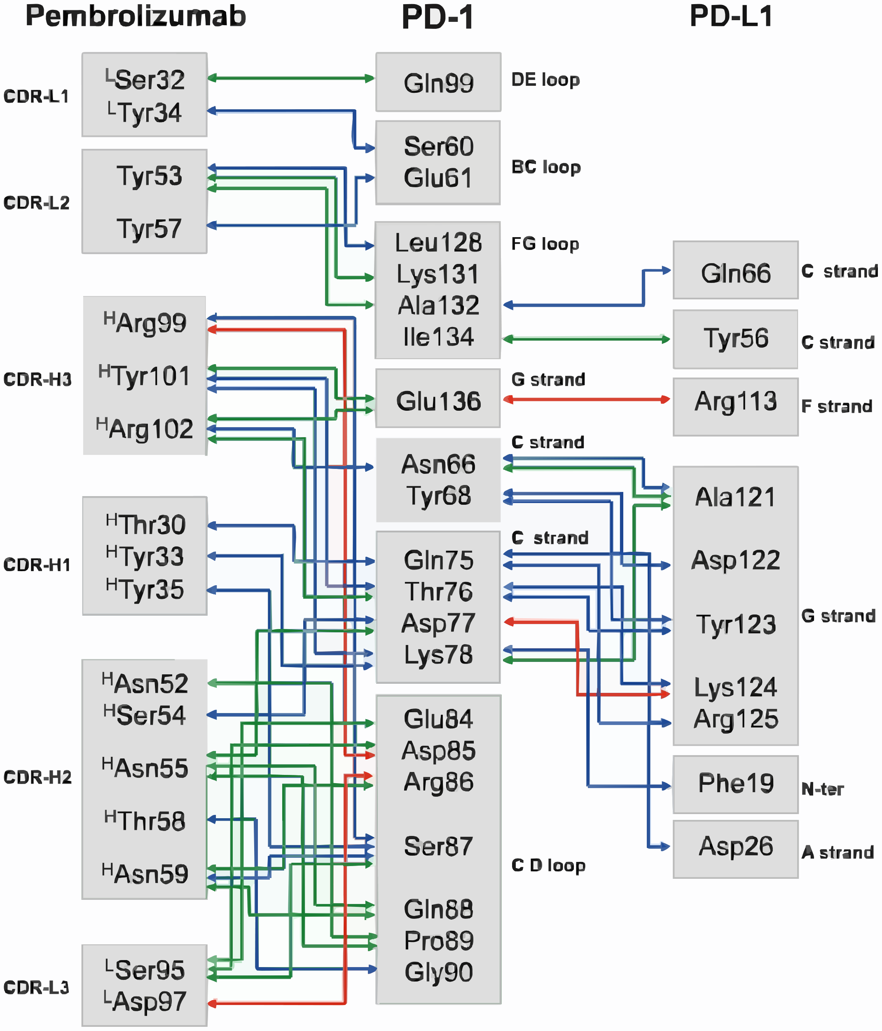
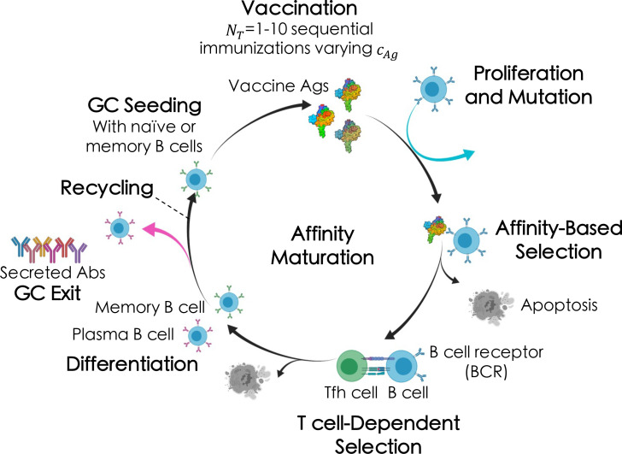
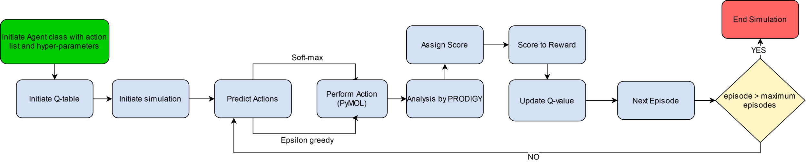
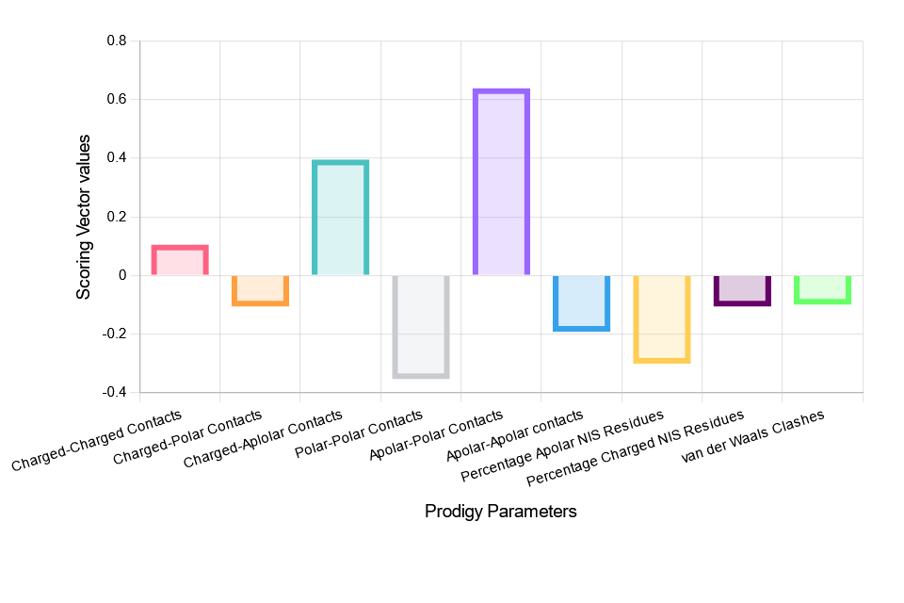
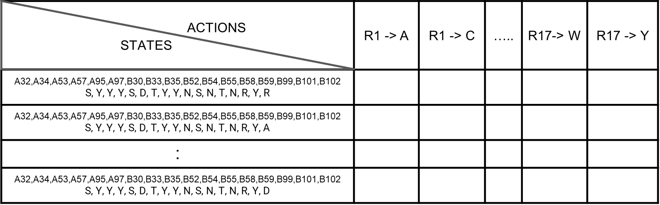
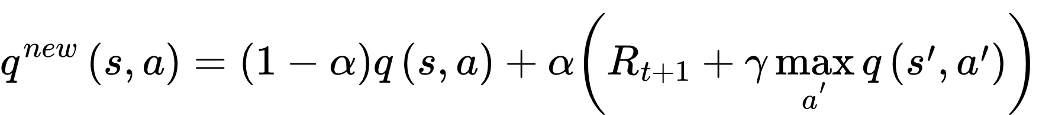
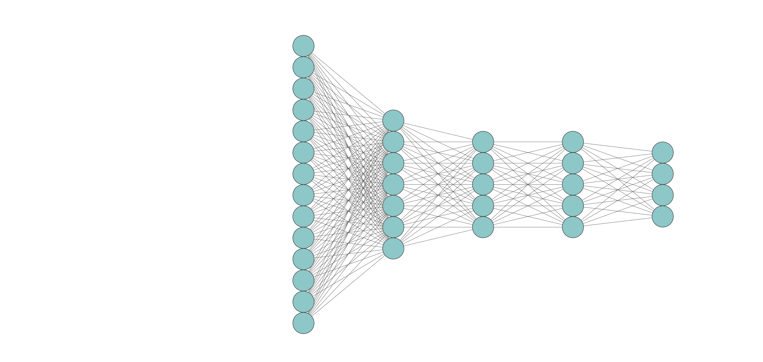
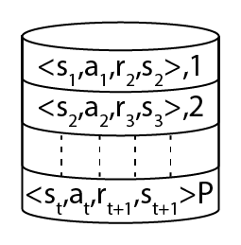
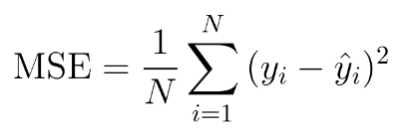
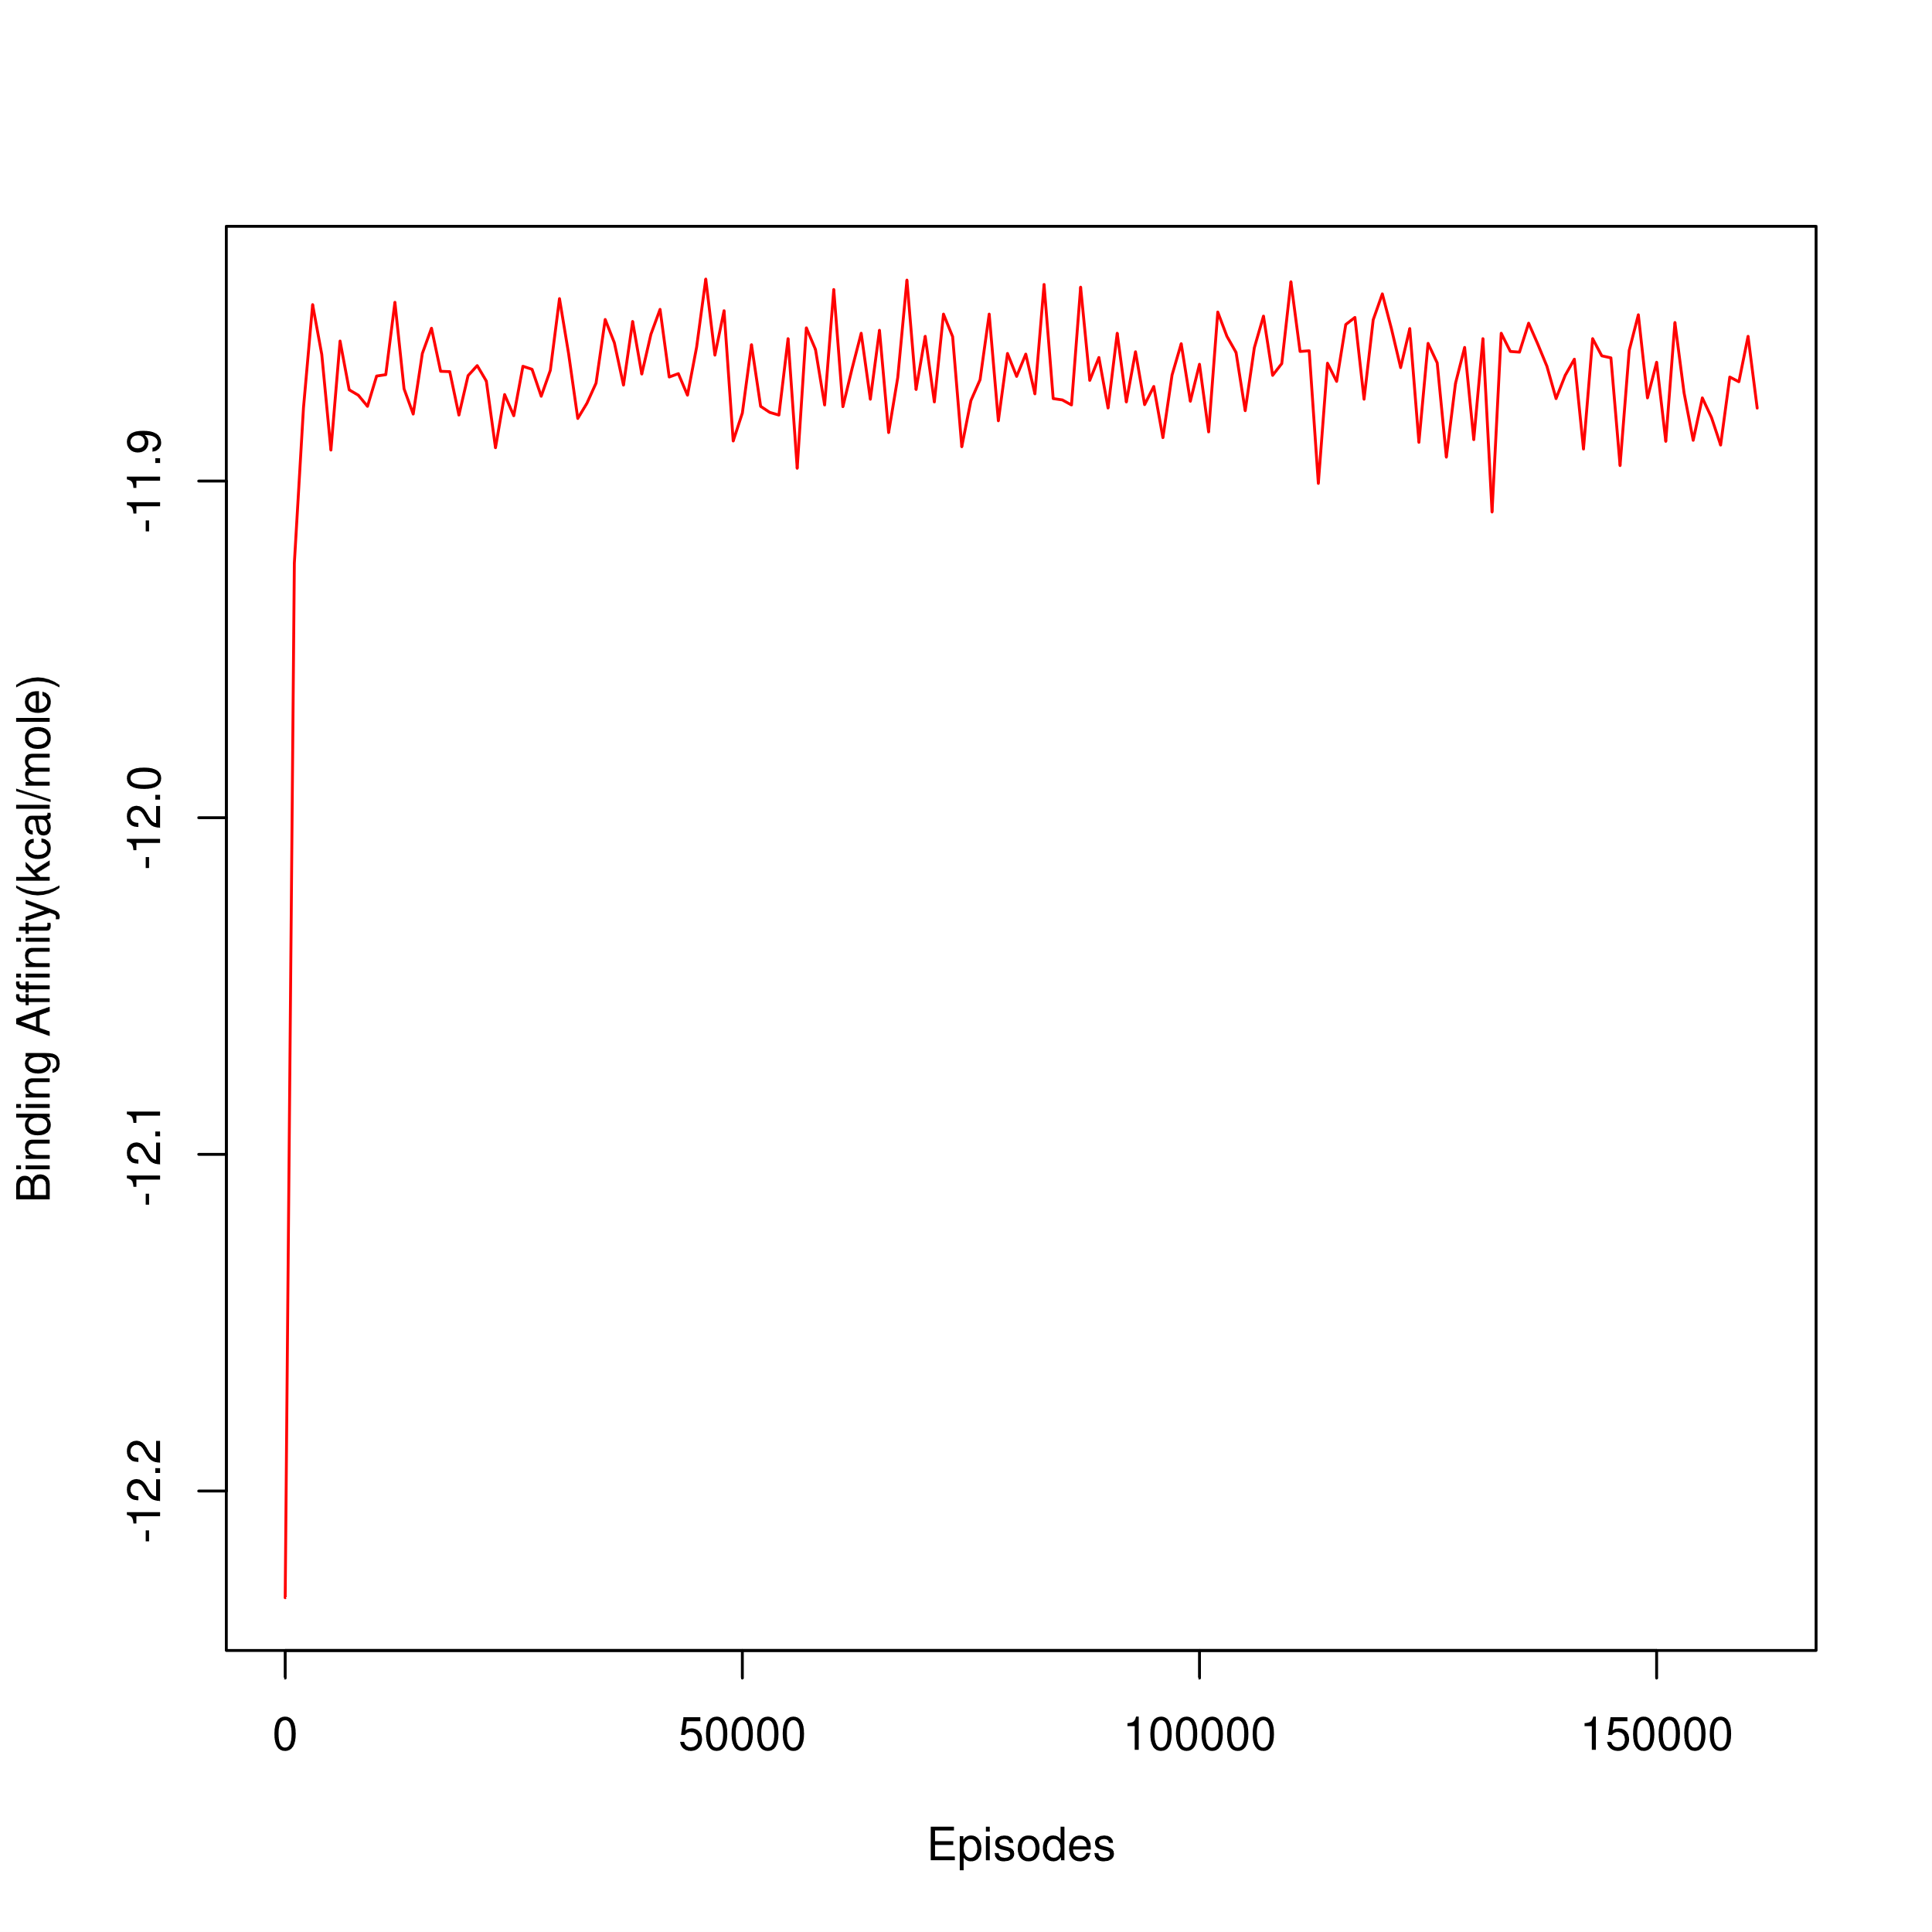
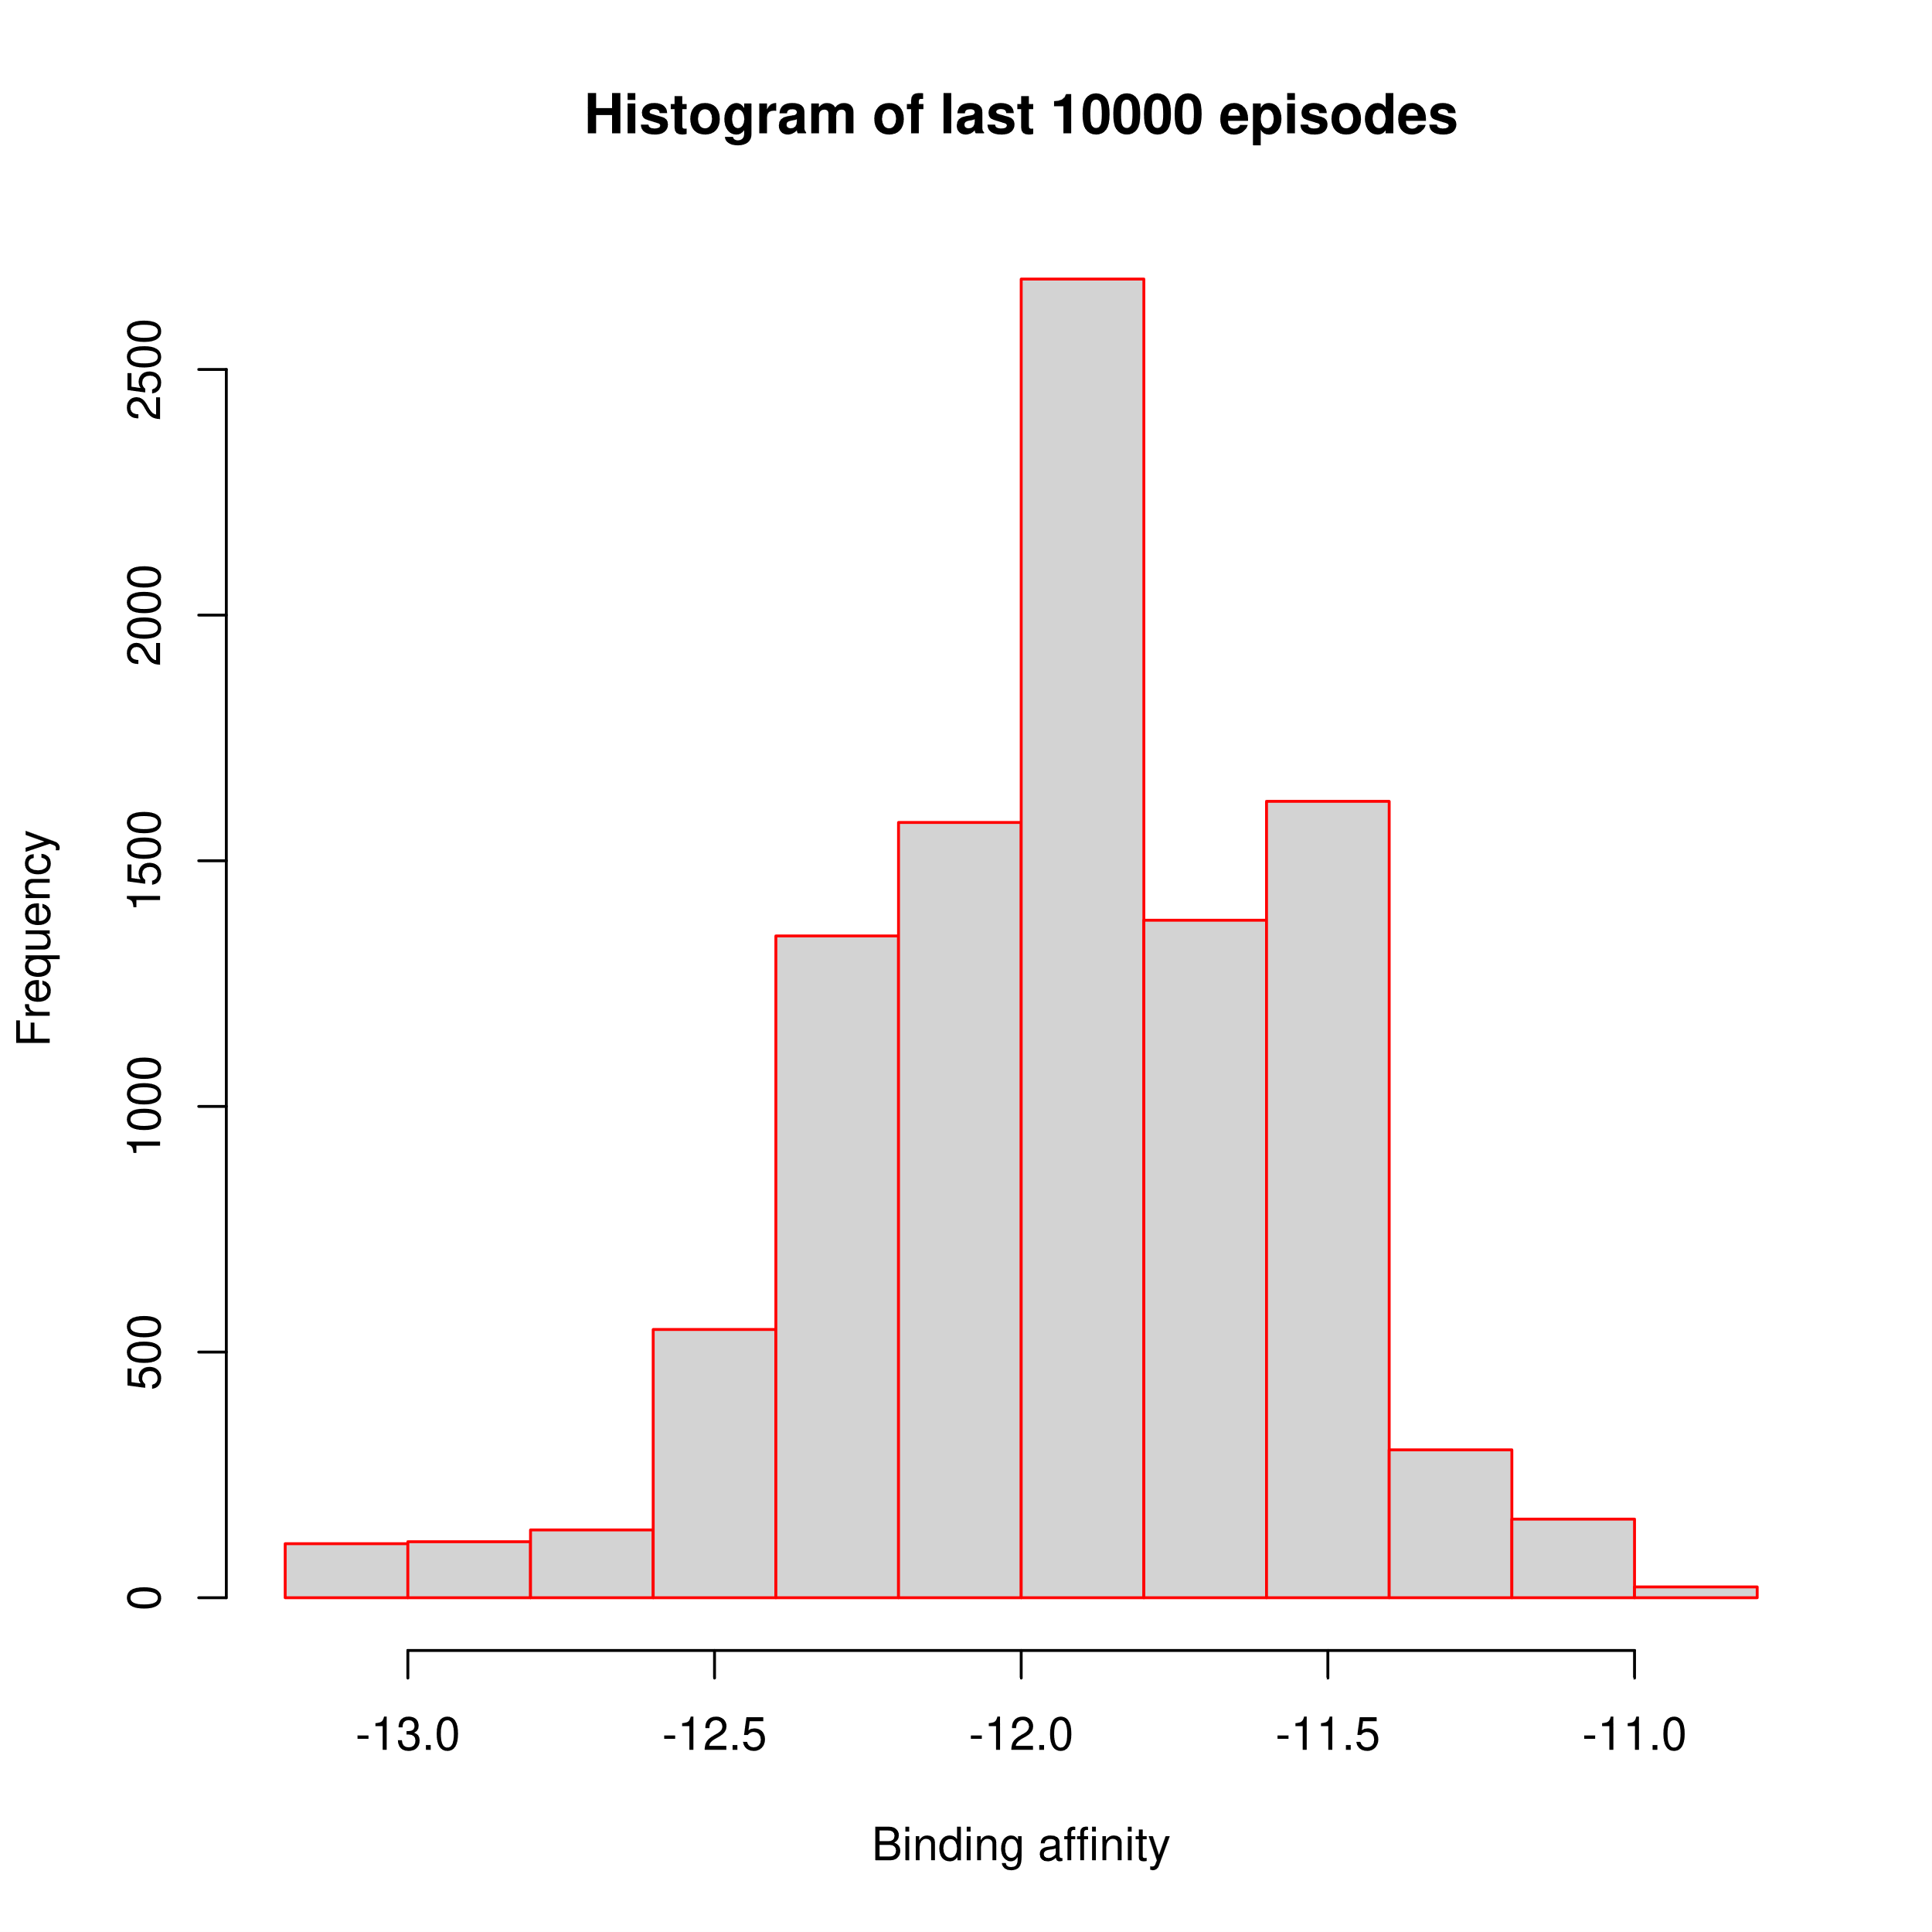
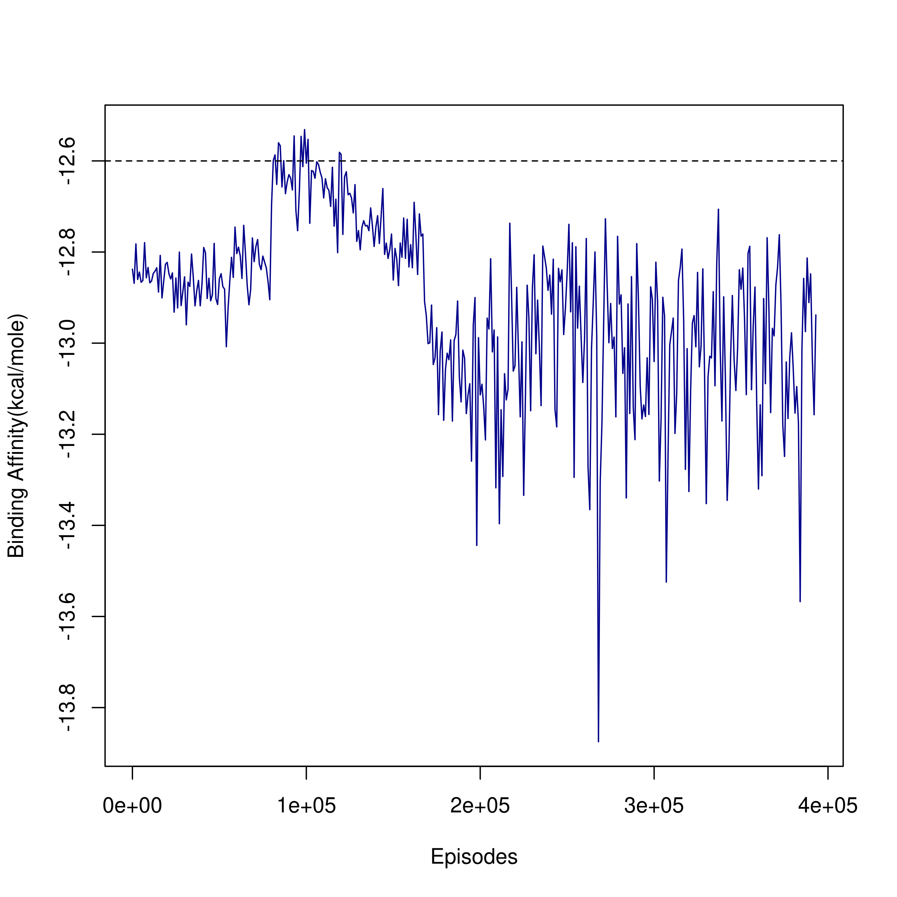
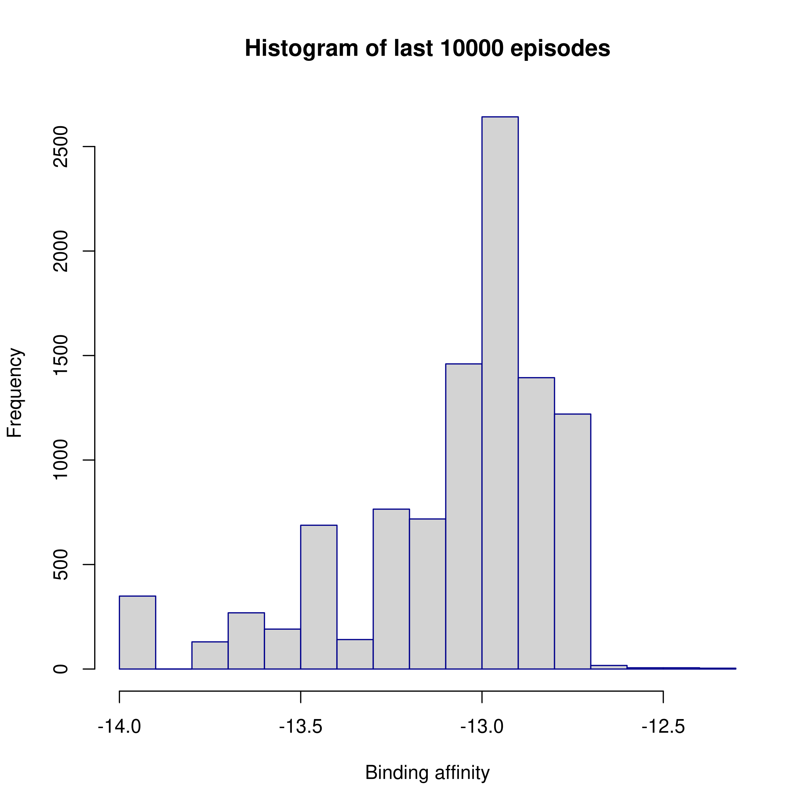
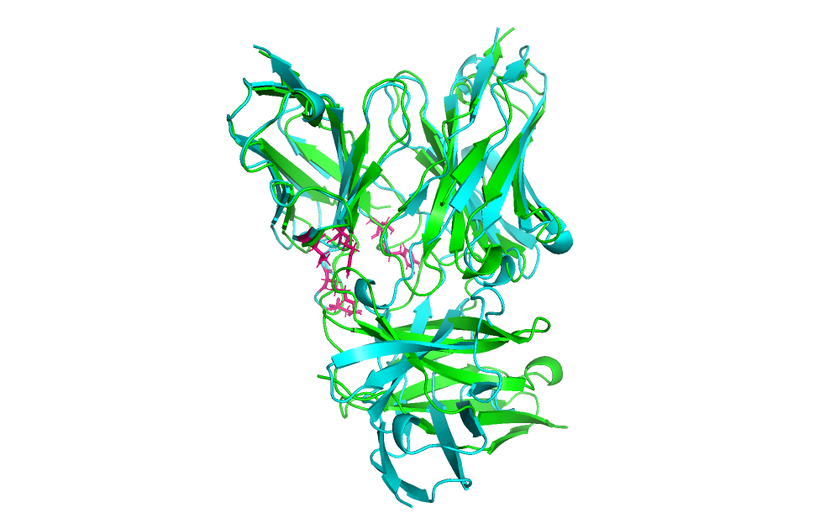
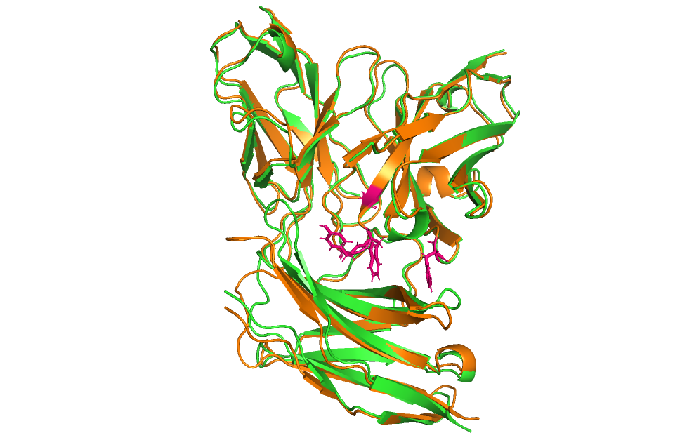
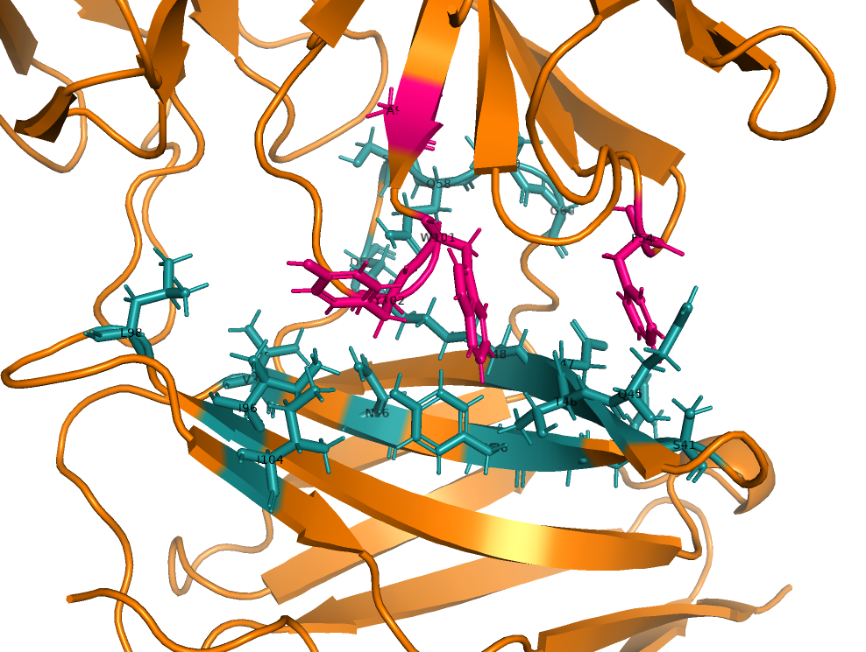
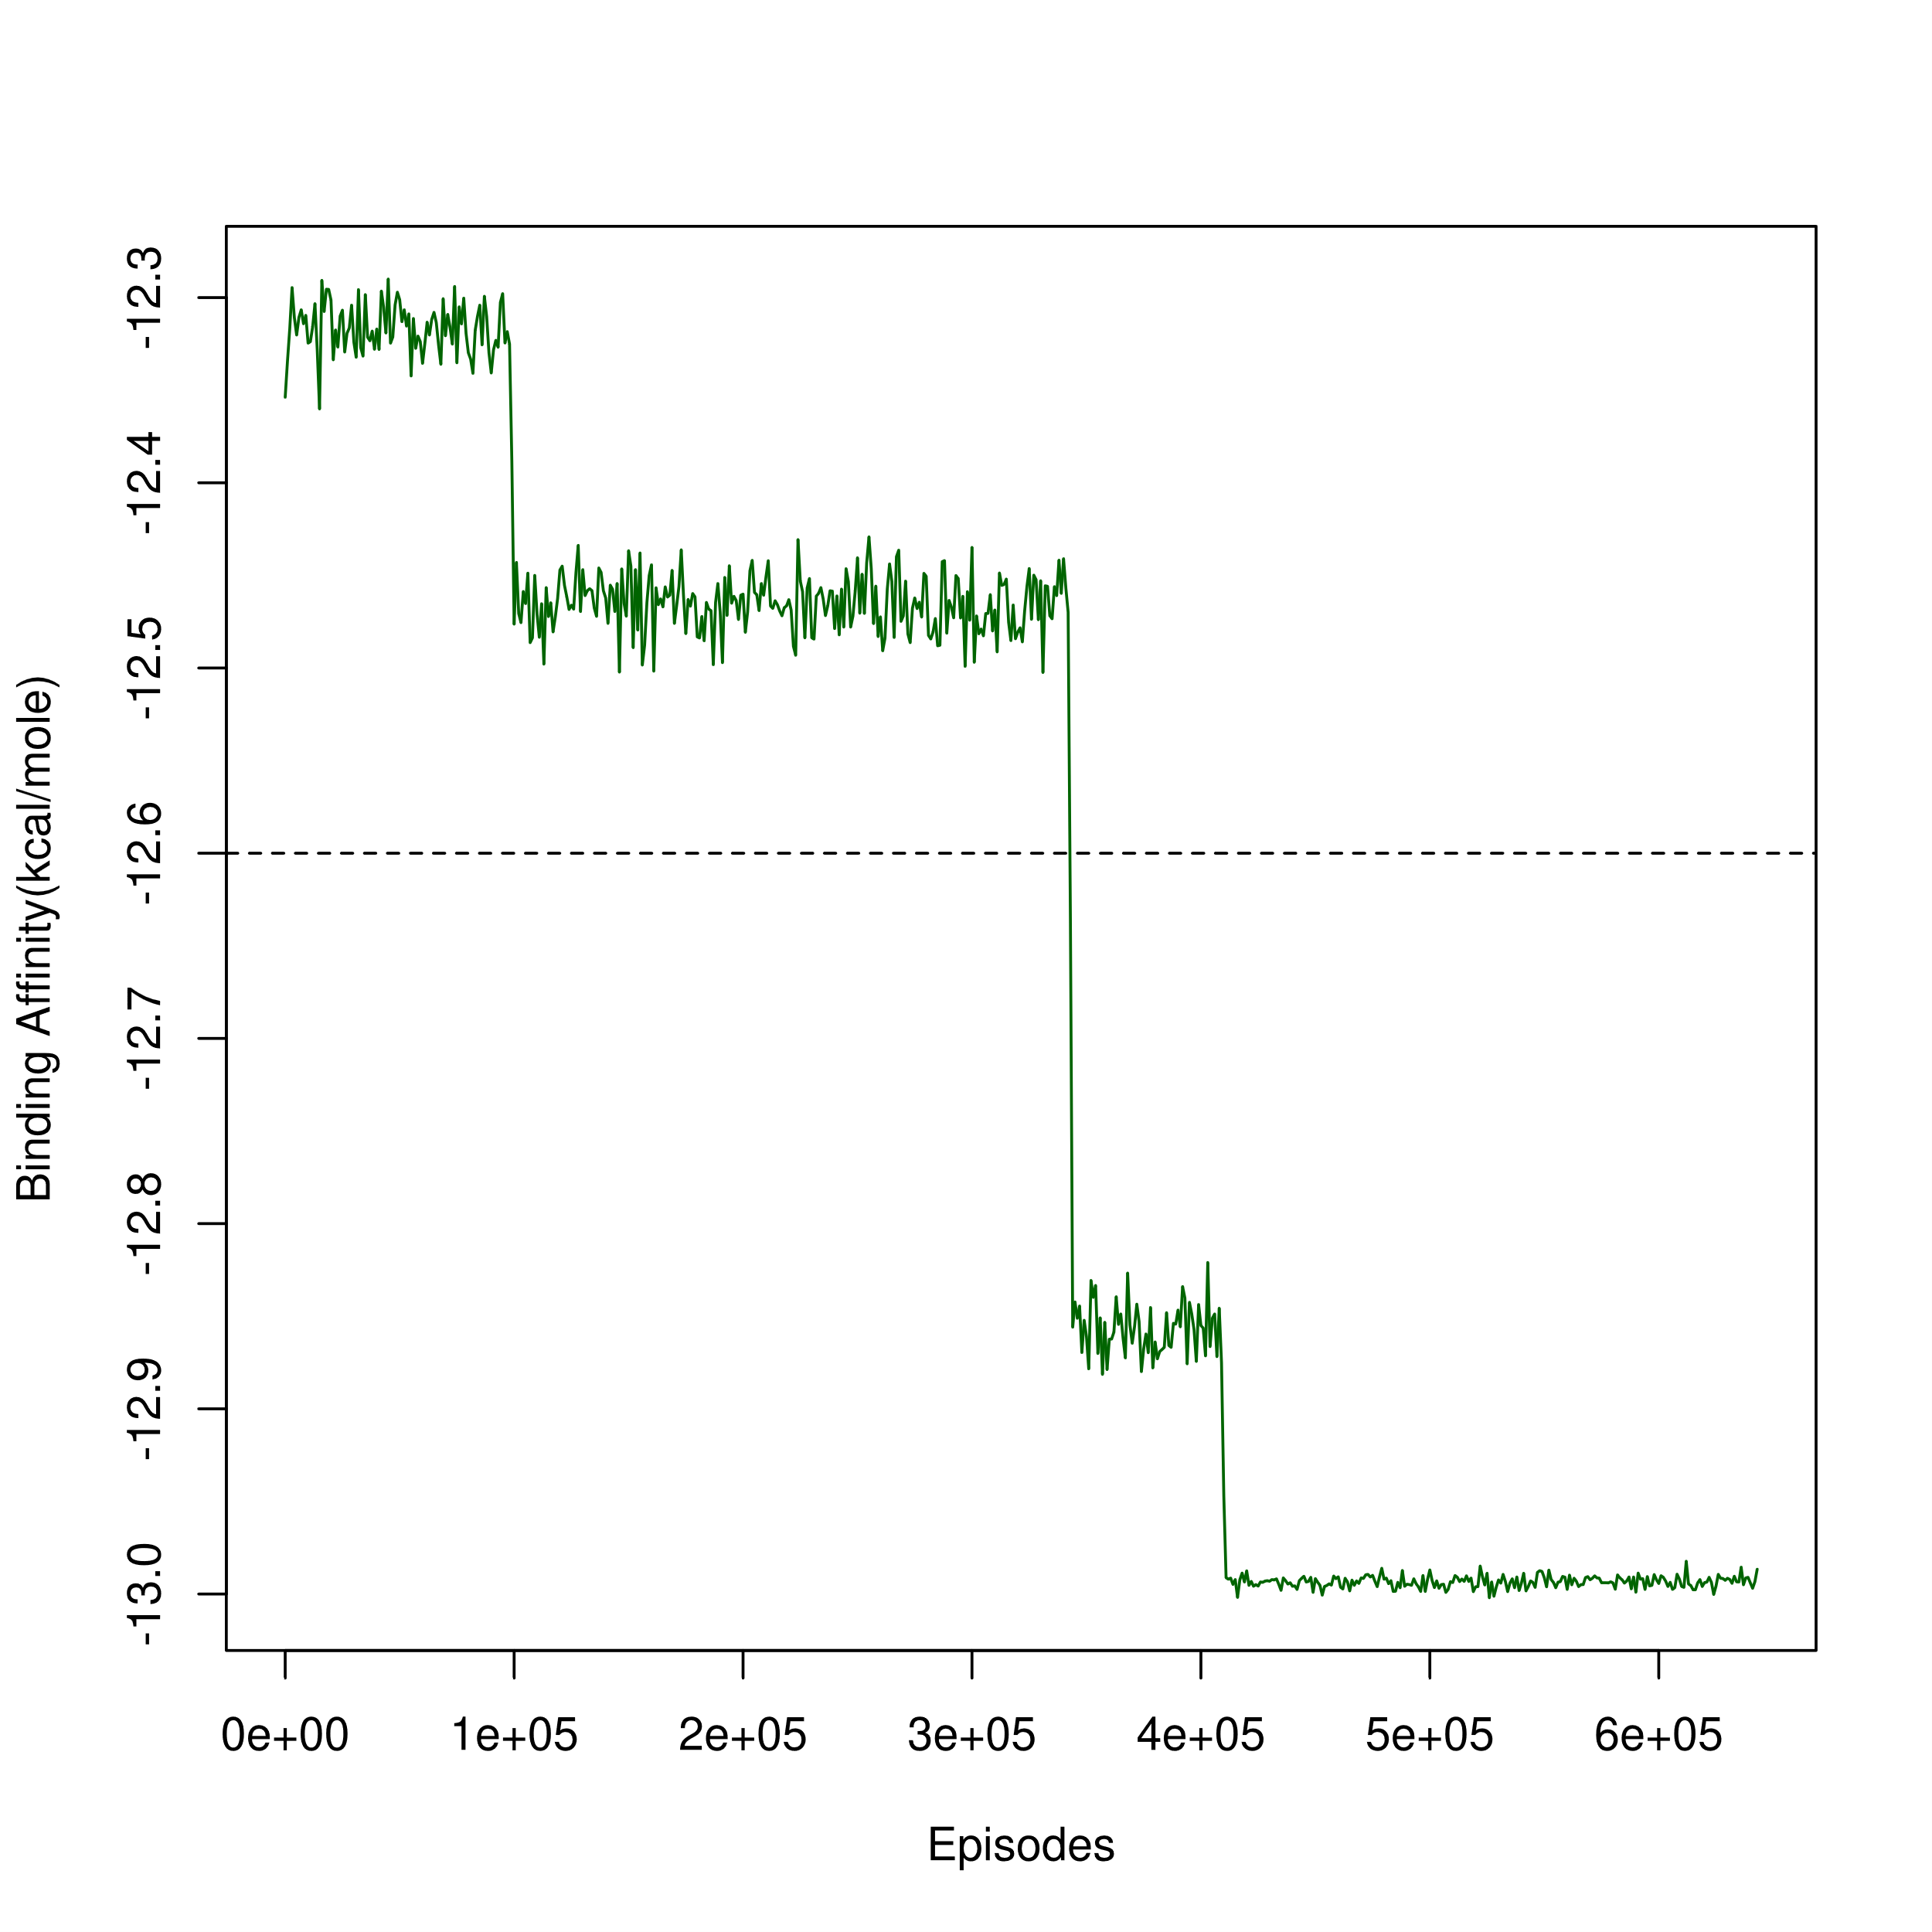
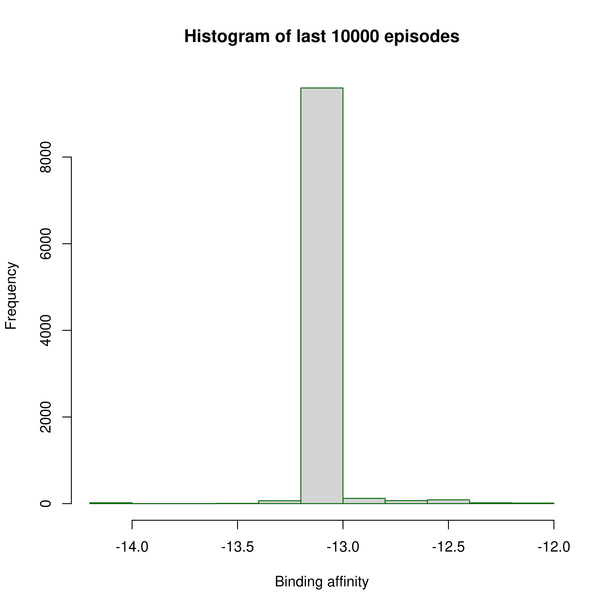
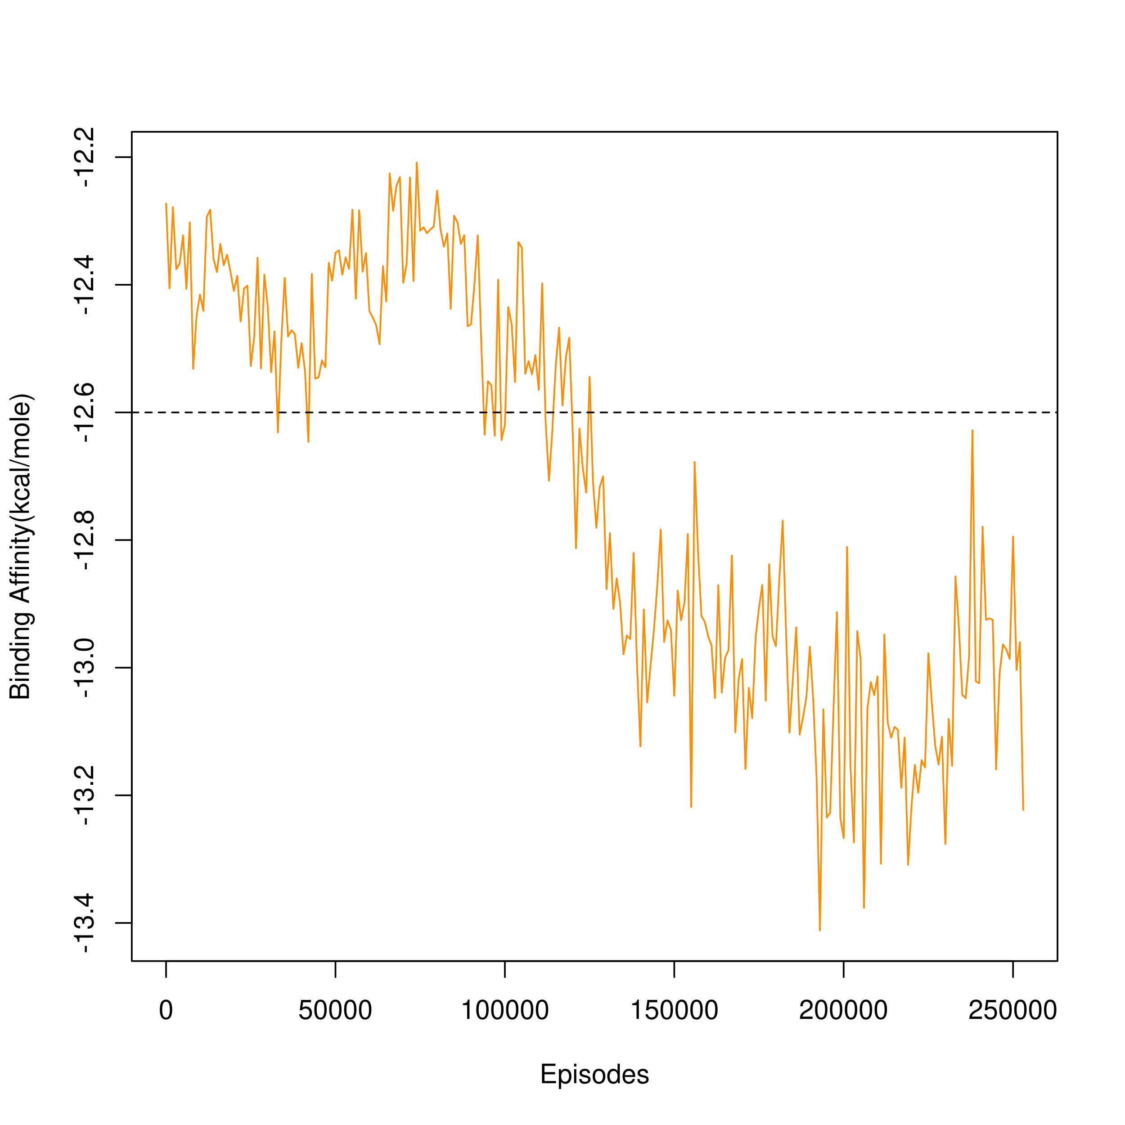
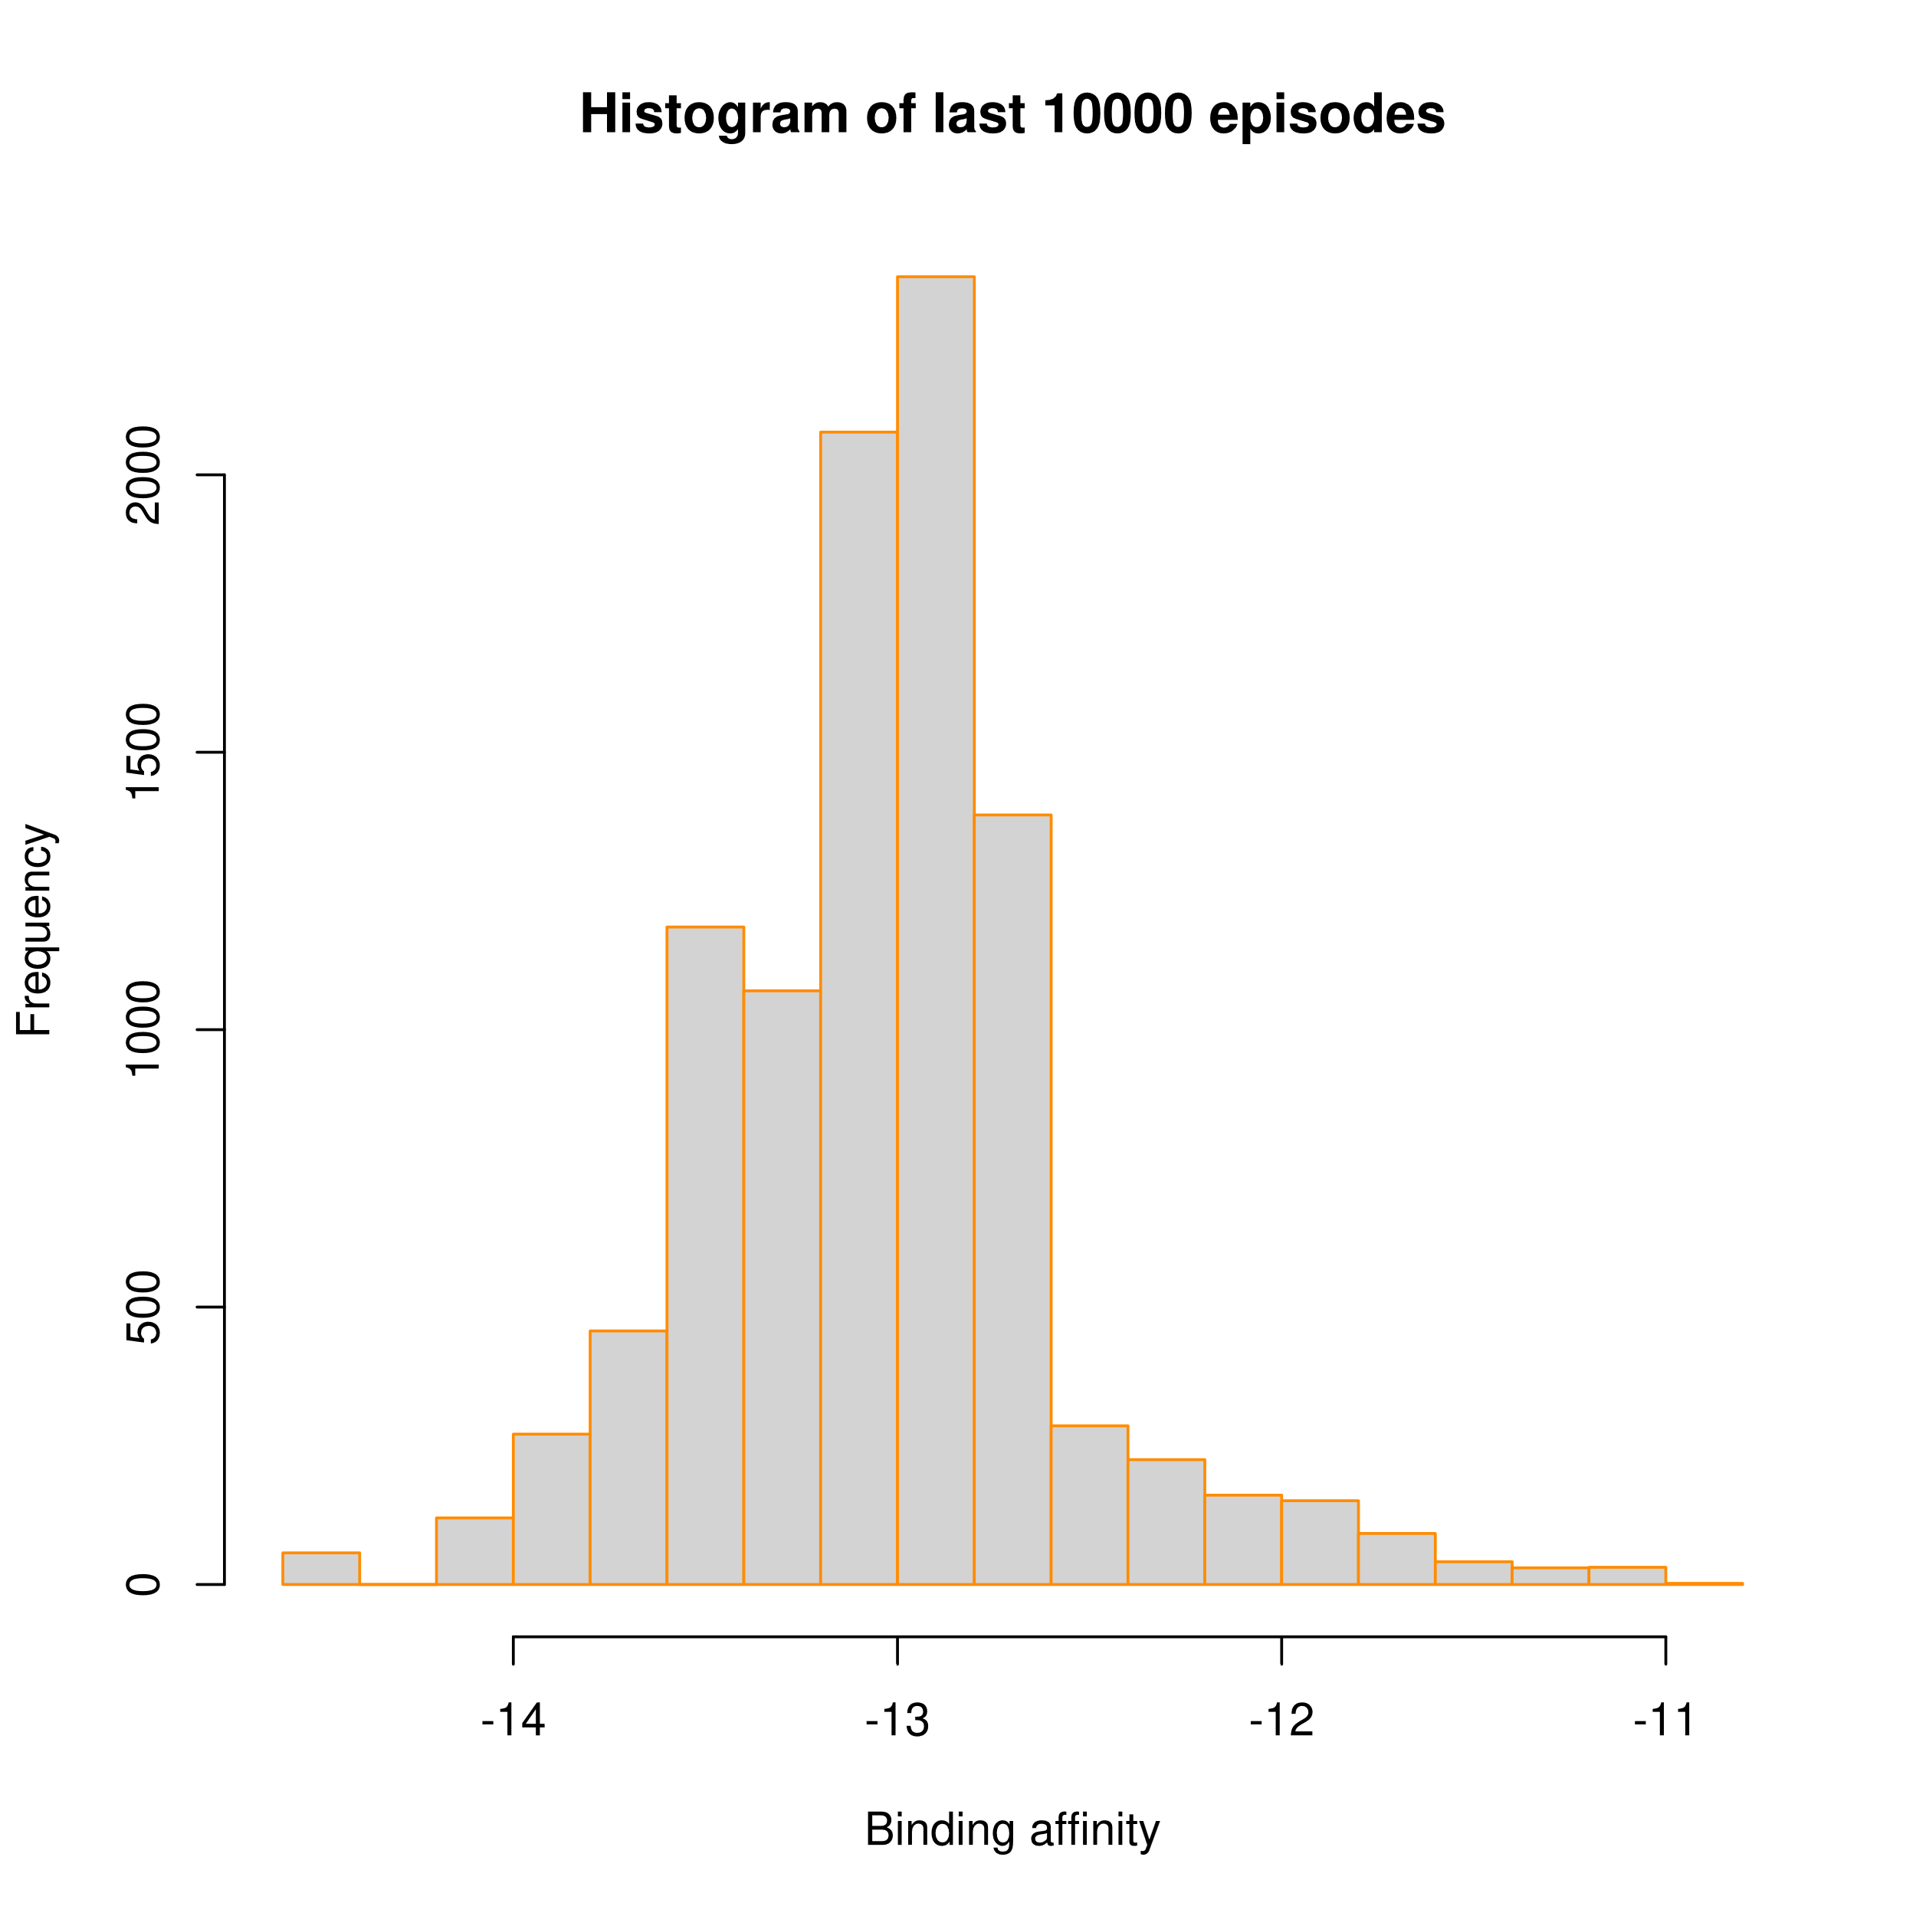
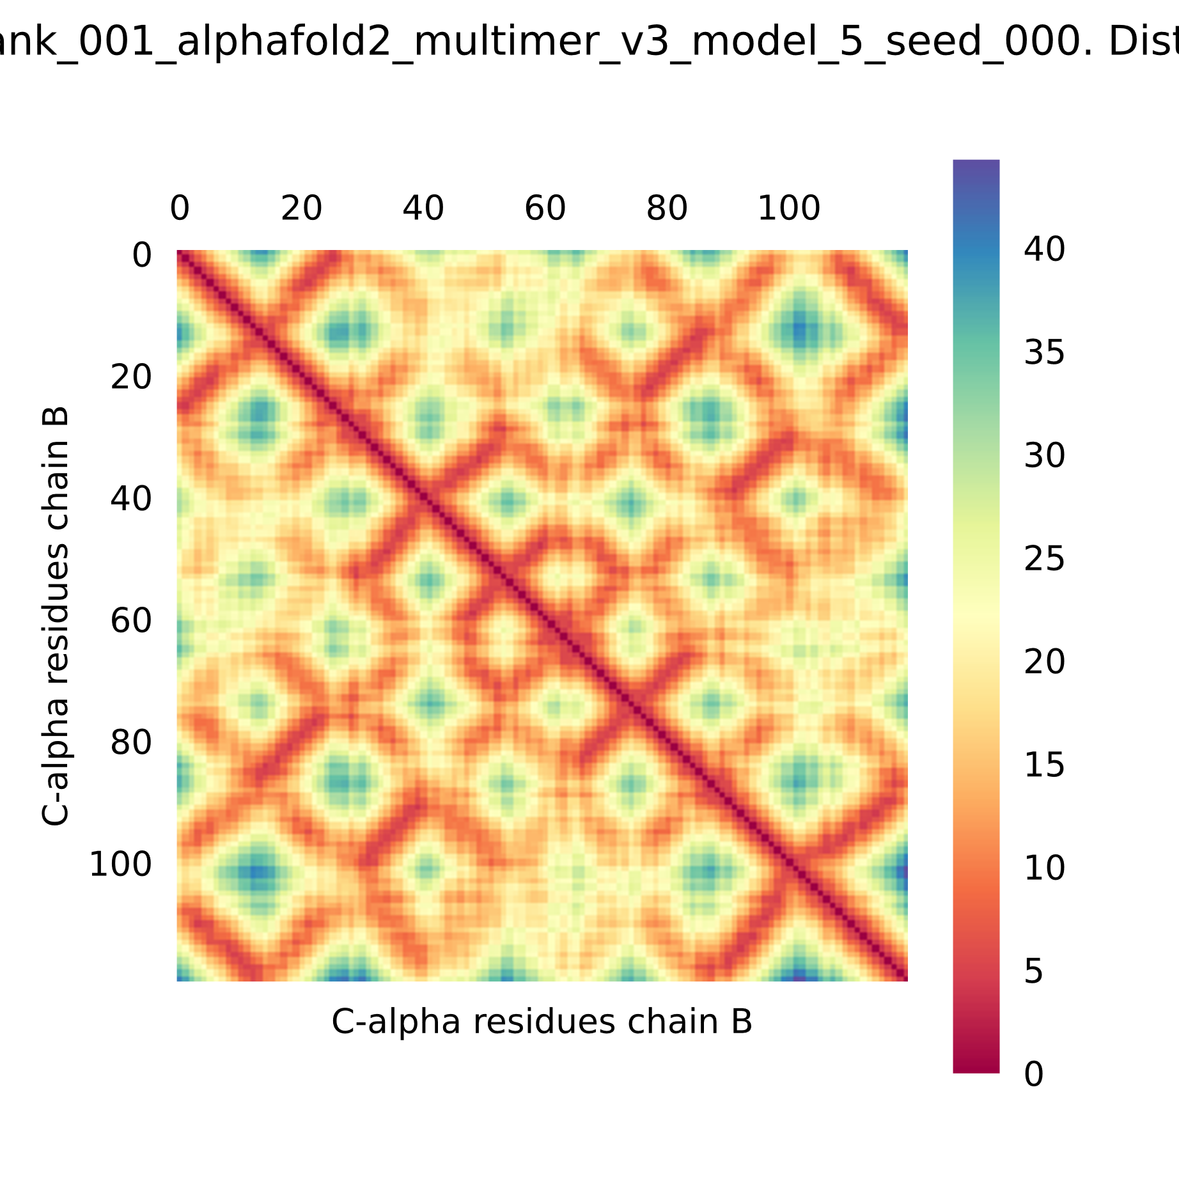
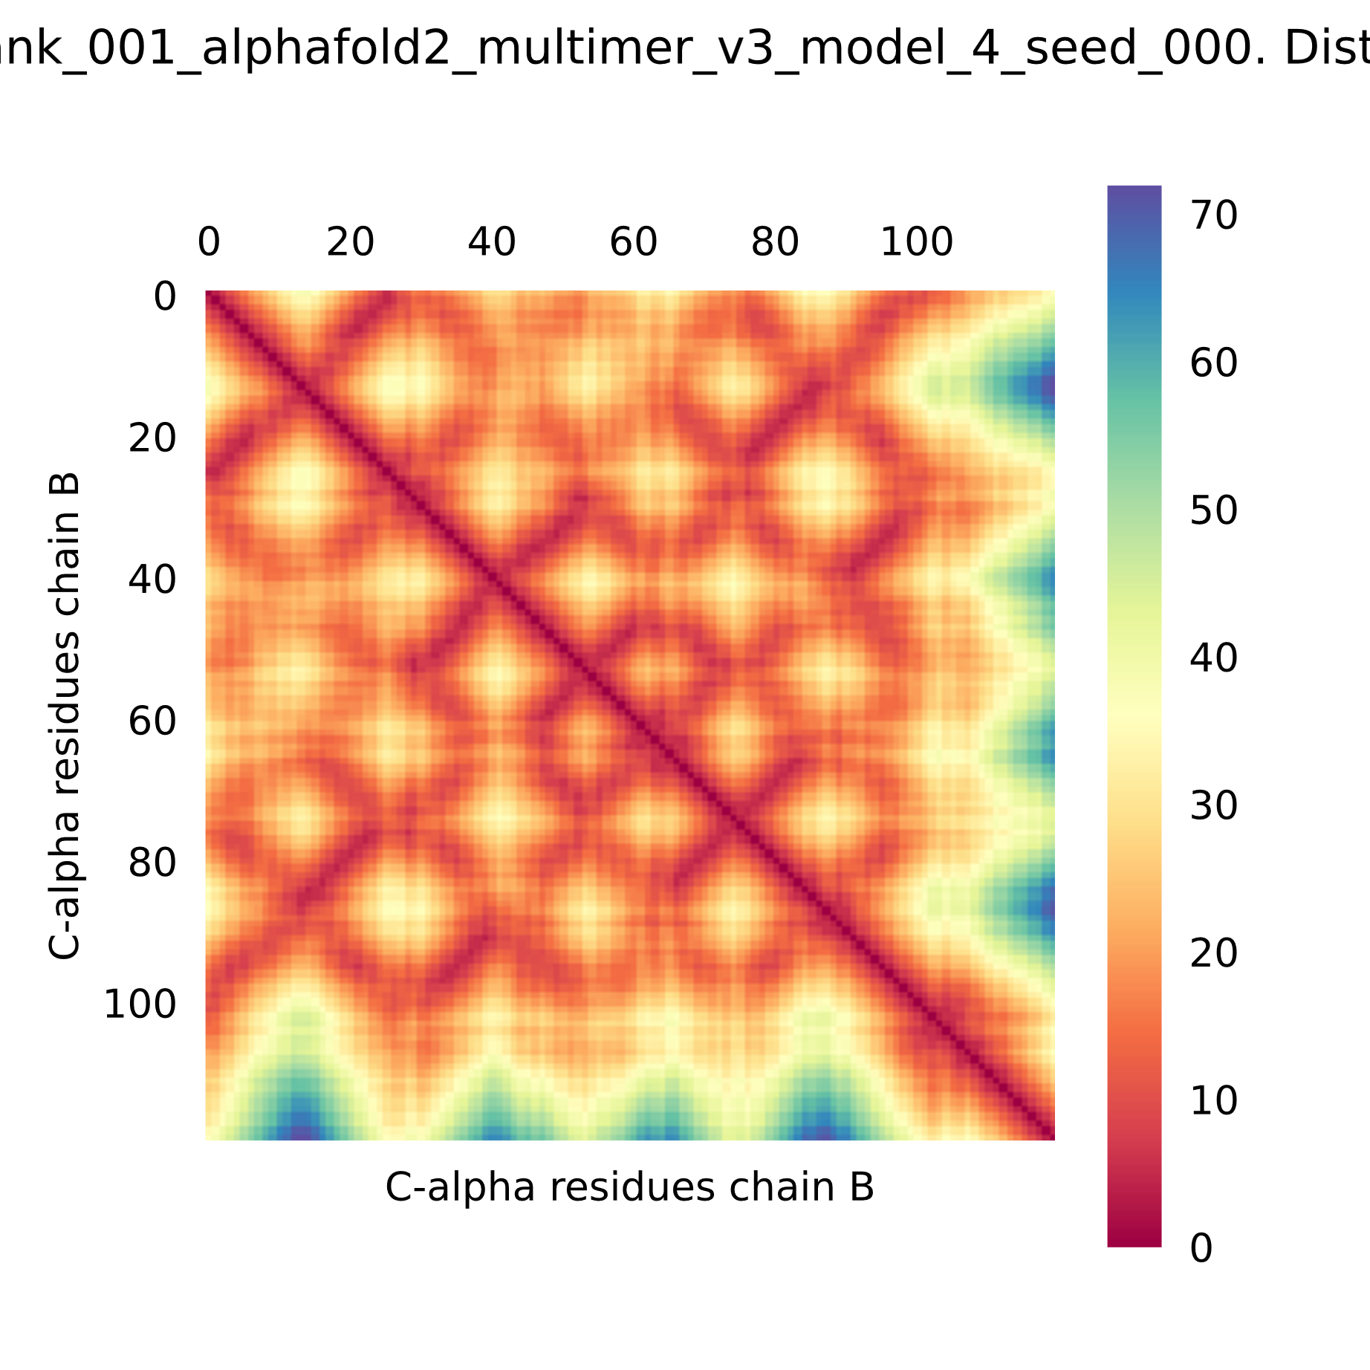
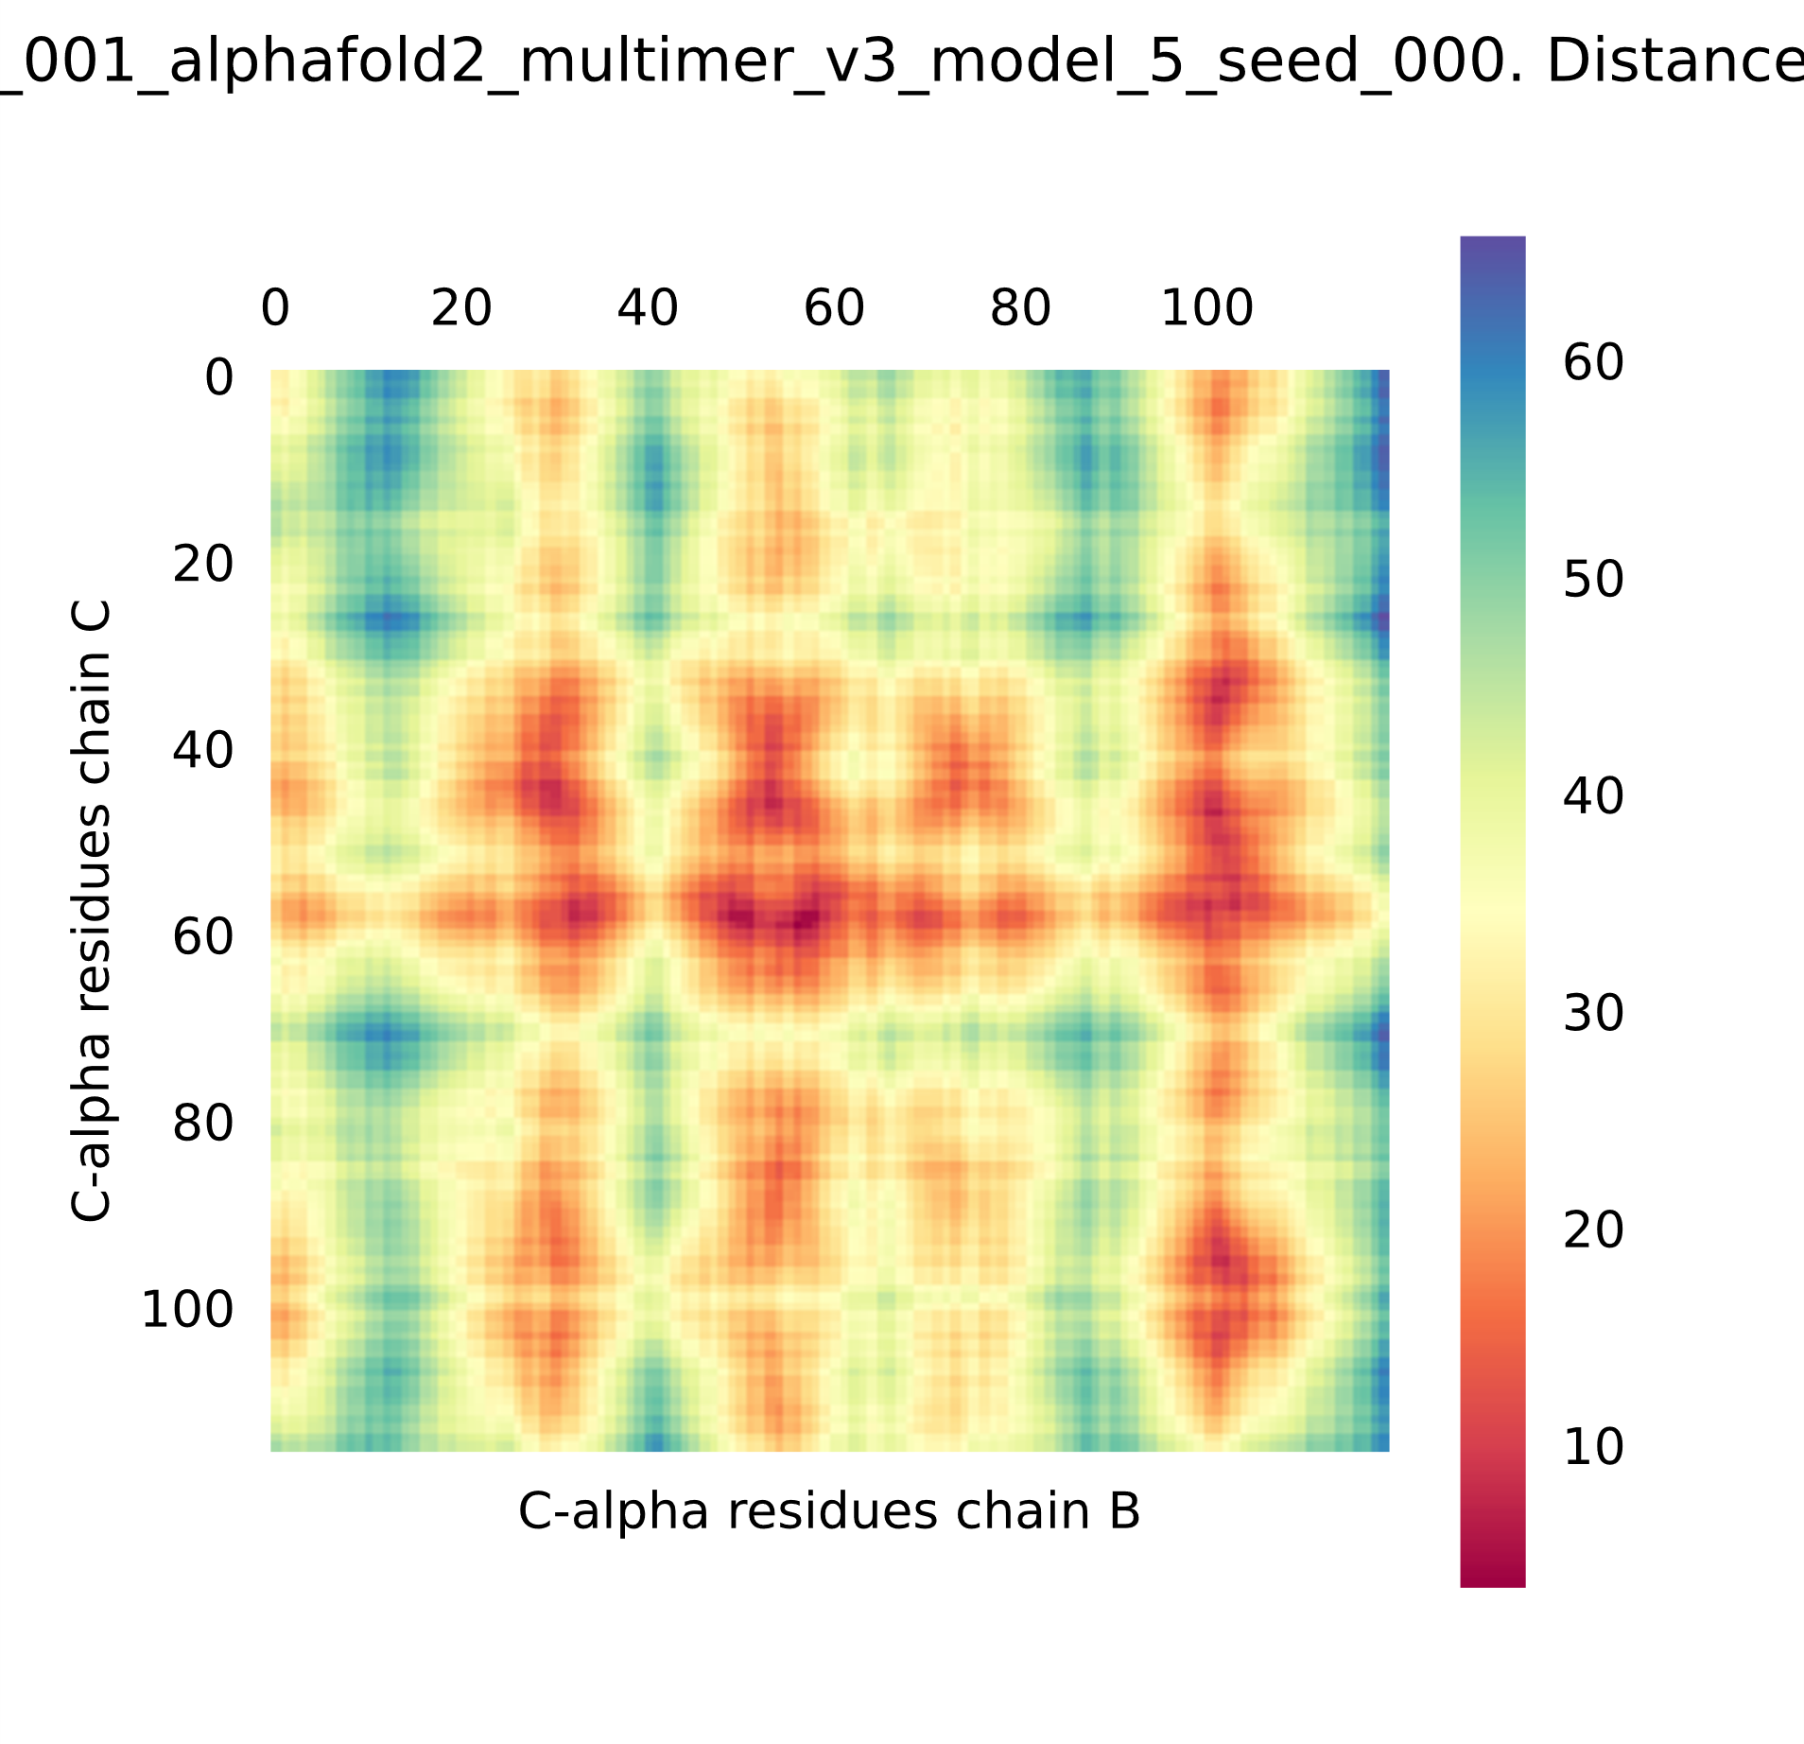
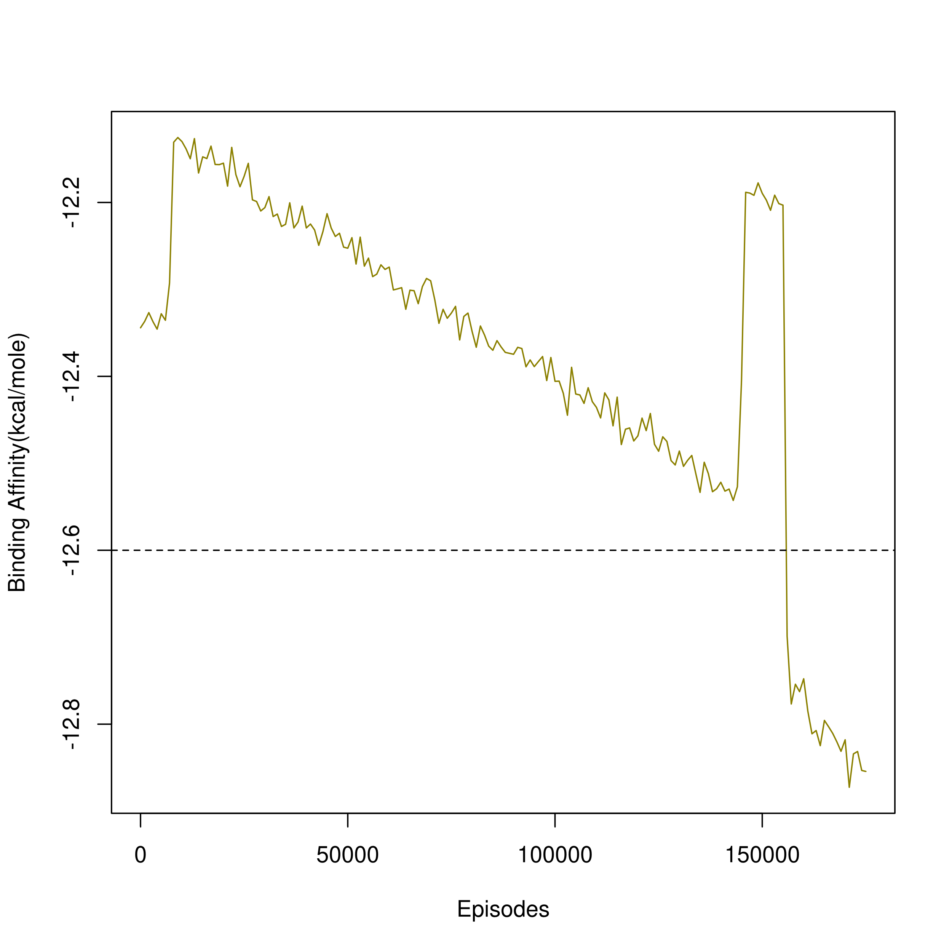
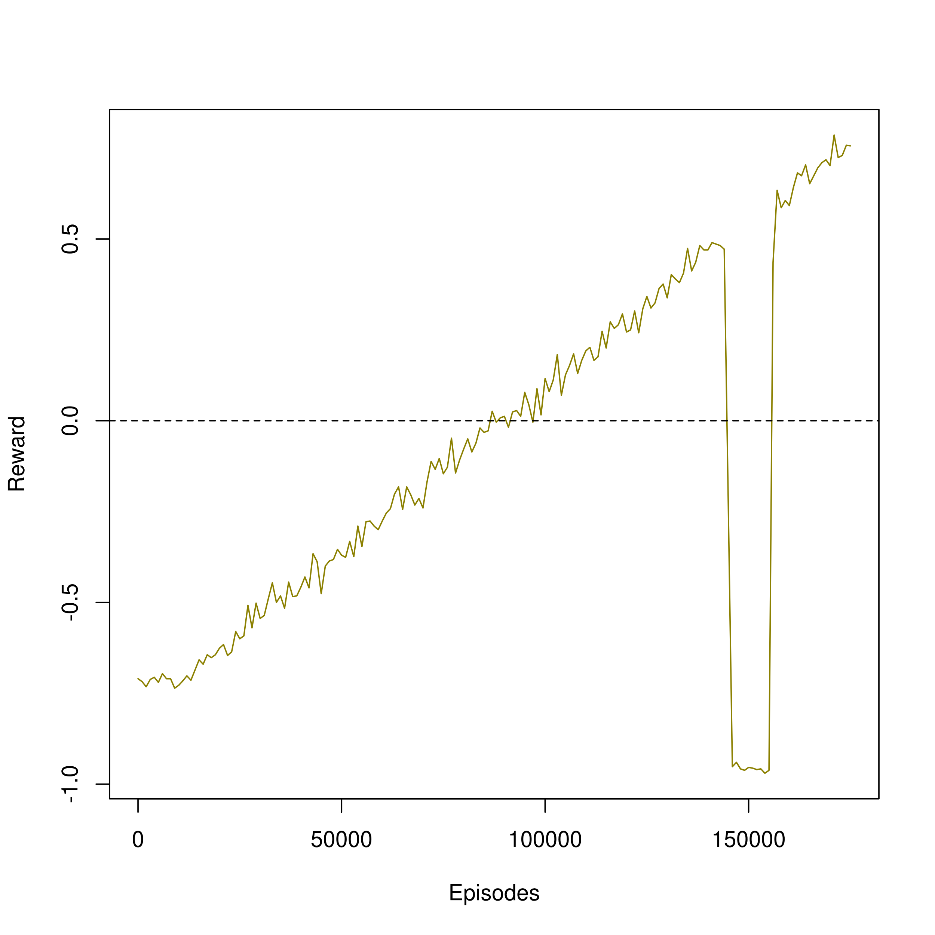
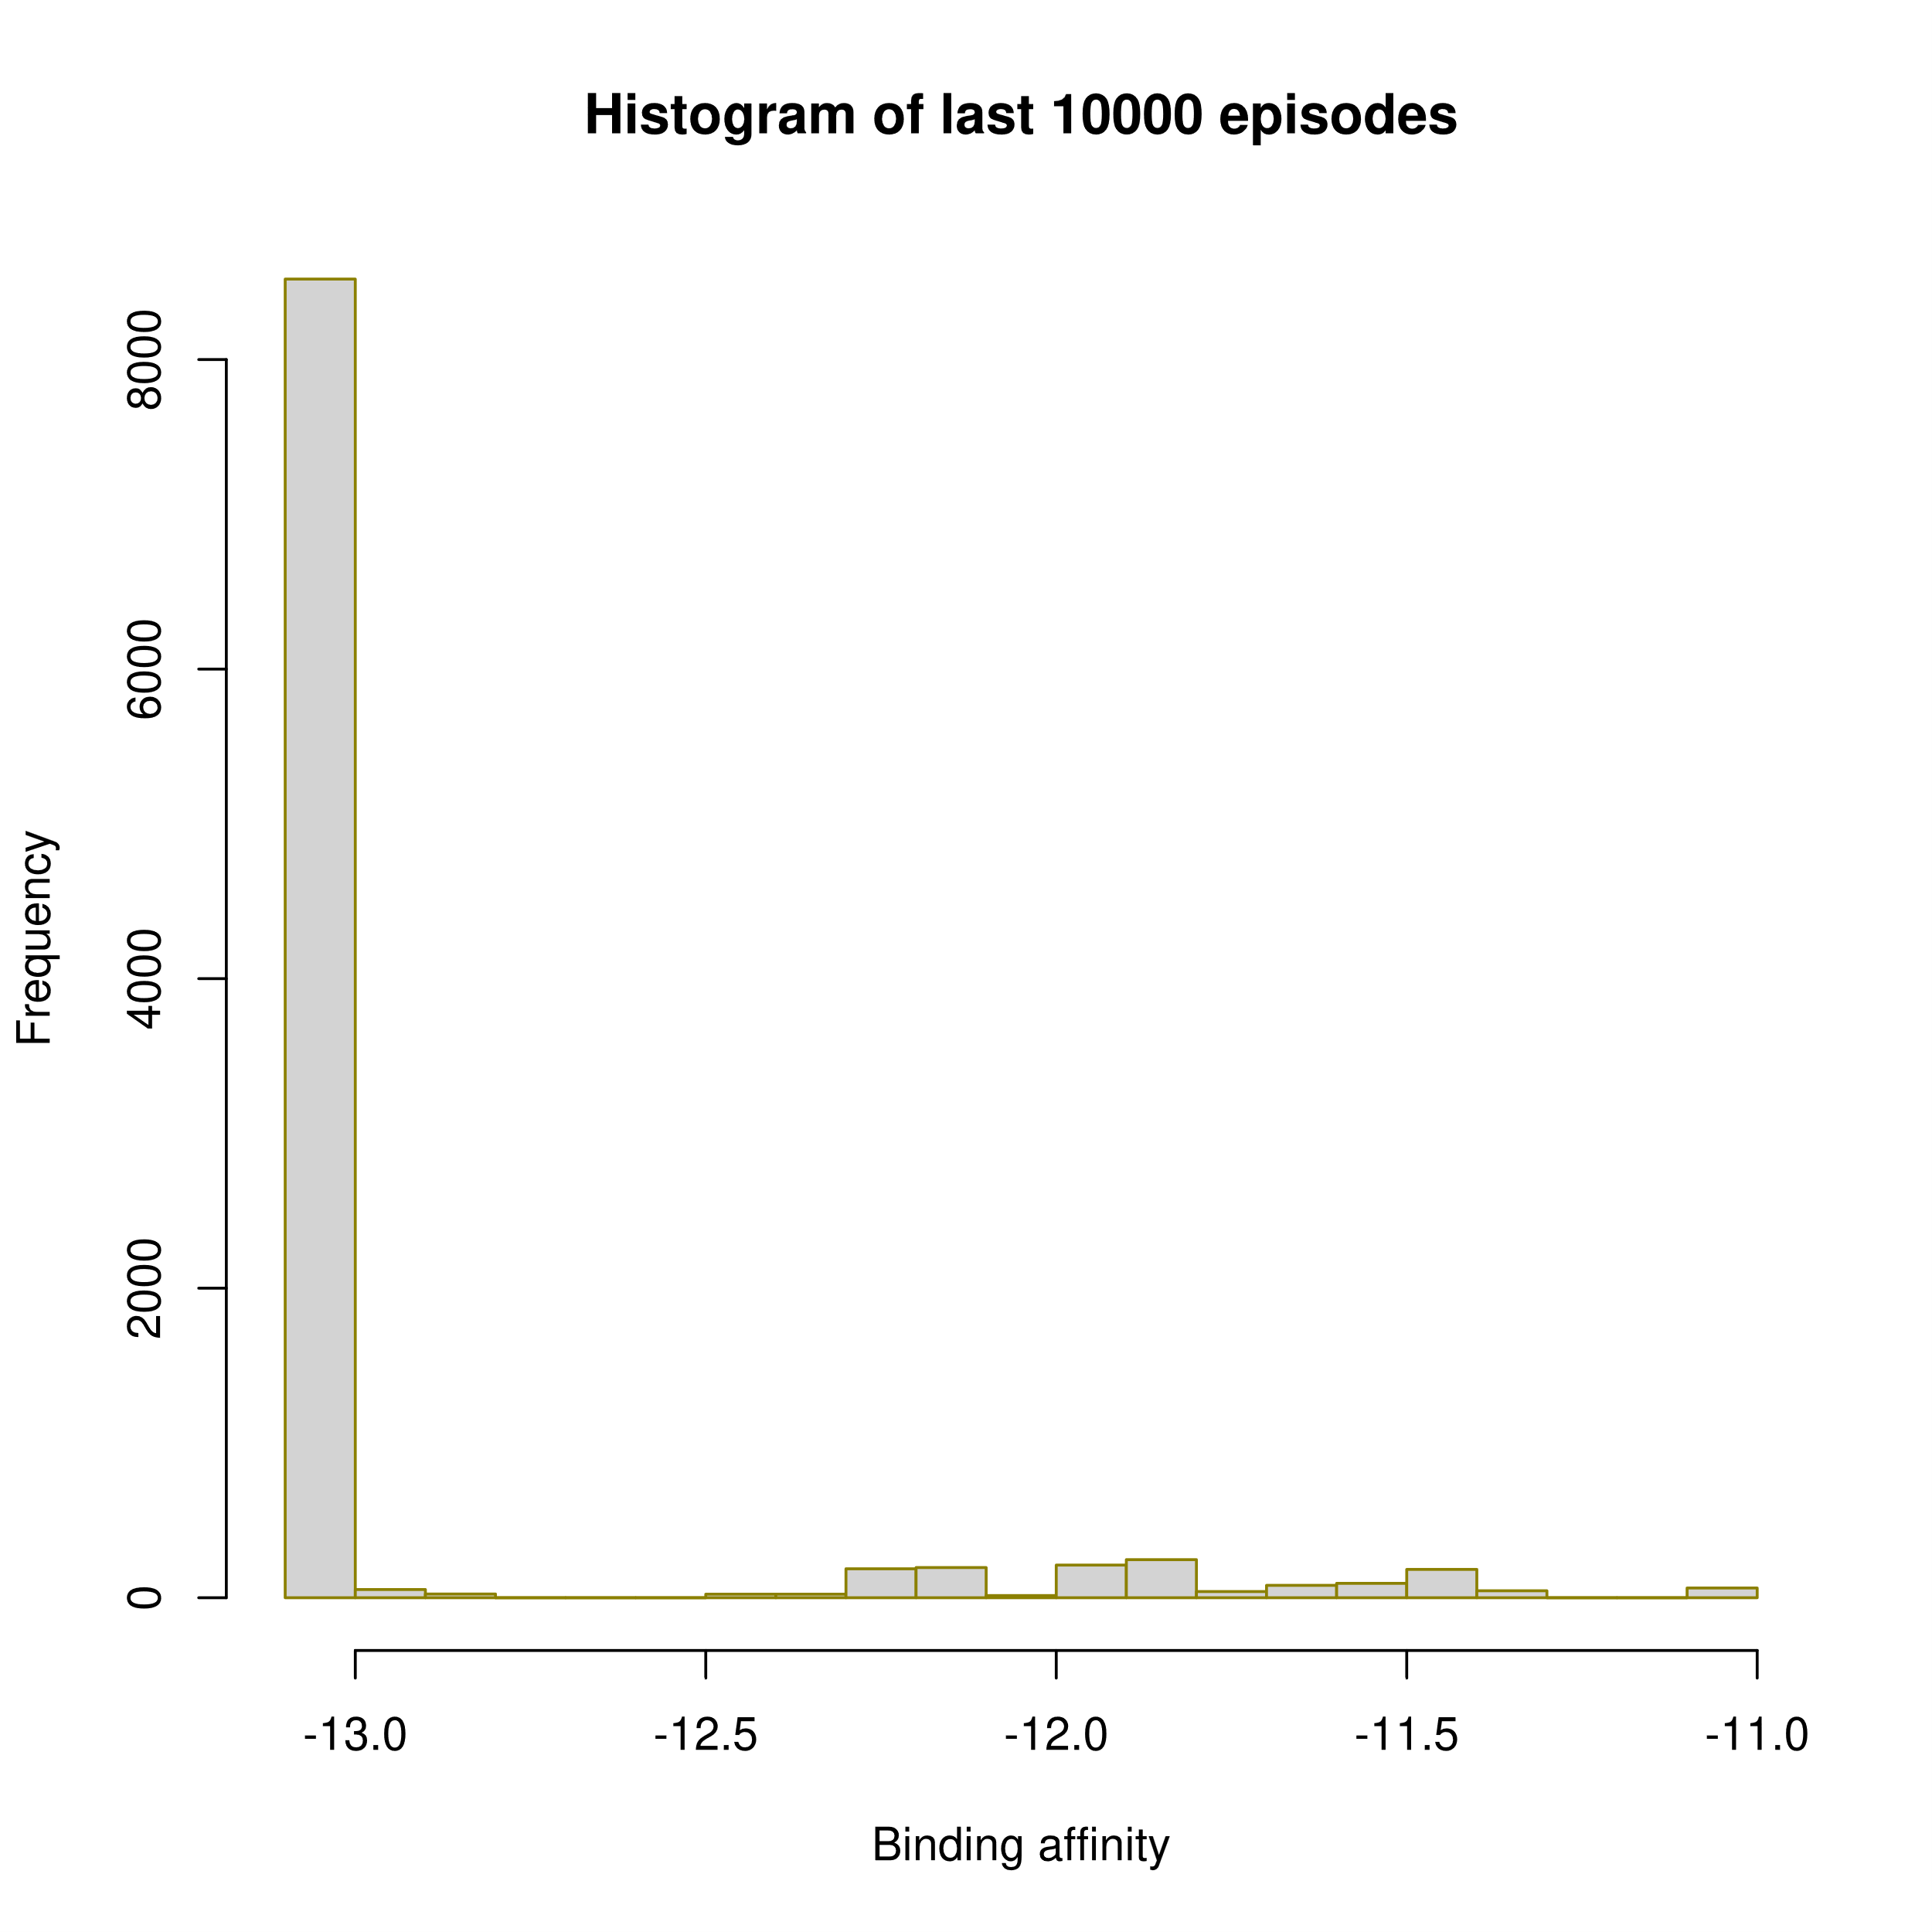
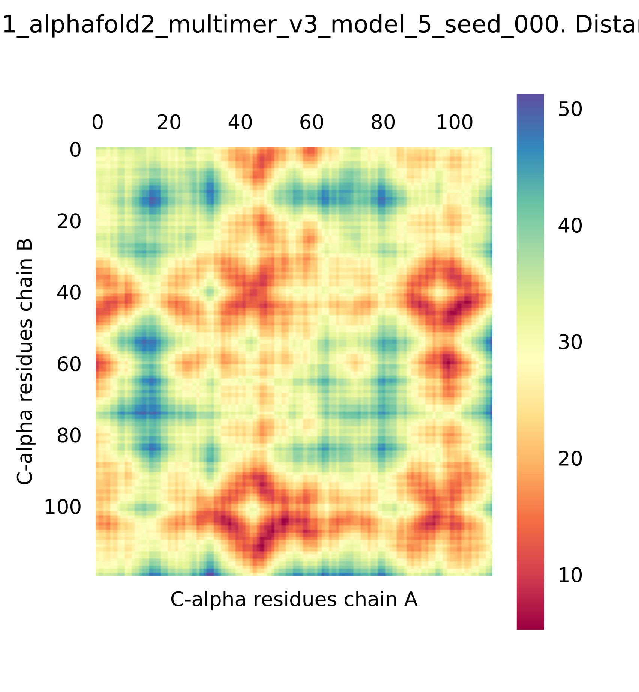
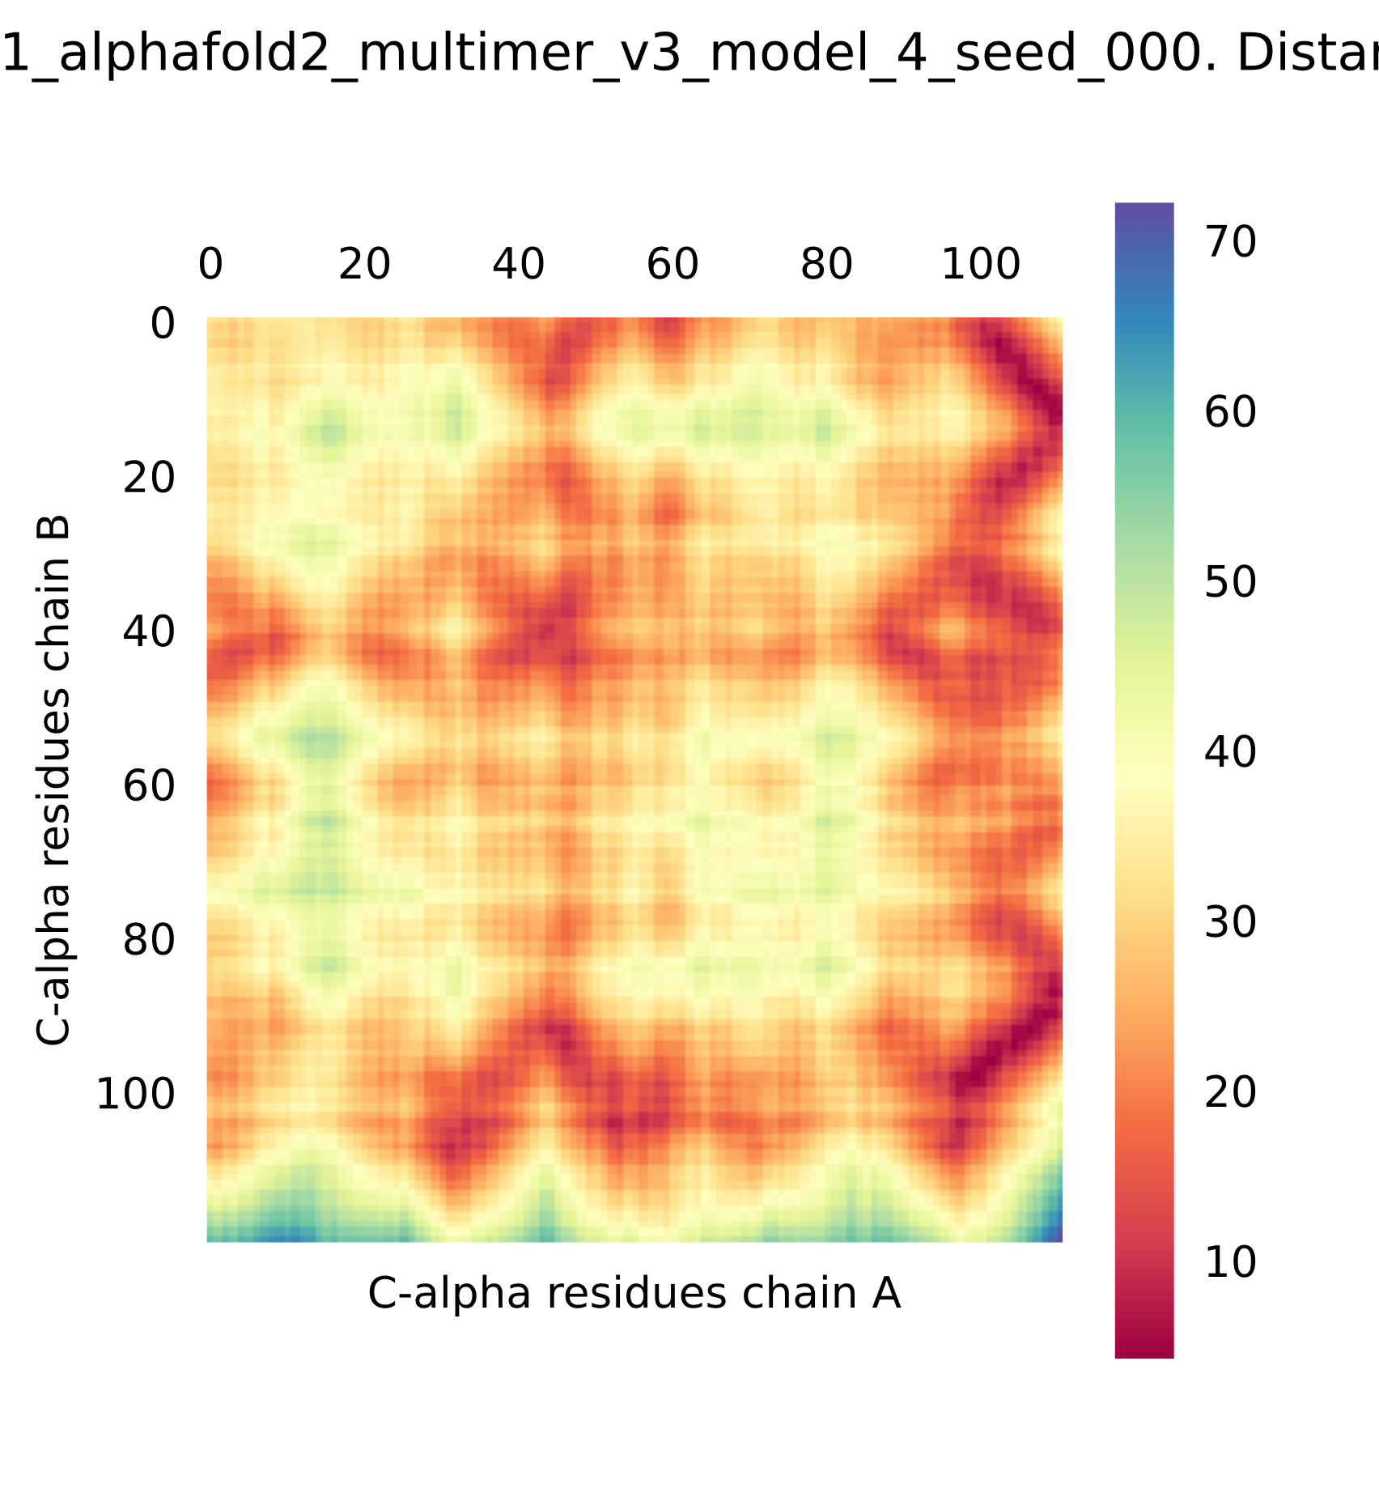
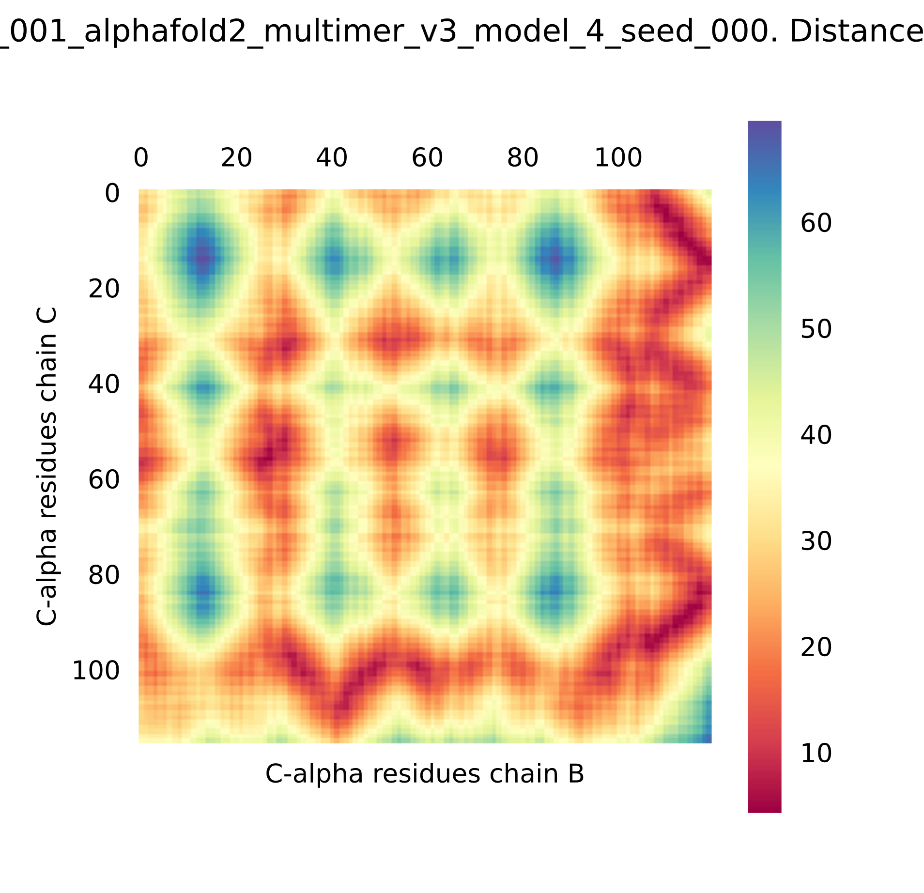
Modelling Somatic Hypermutations with Reinforcement Learning for PD1 and Pembrolizumab
Anmol Singh, Subhashini Srinivasan, Nithya Ramakrishnan
Institute of Bioinformatics and Applied Biotechnology - Biotech Park, Electronics City Phase 1, Electronic City, Bengaluru, Karnataka 560100
ABSTRACT
INTRODUCTION
We present a reinforcement learning (RL) model for Somatic Hypermutations (SHM), which mimics the natural selection process in a very short time scale. In this model, the agent can learn to preferentially mutate amino acids in the antibody, leading to affinity maturation. The model thus predicts a higher binding affinity antibody than the initial antibody-antigen complex. We have used the Pembrolizumab-PD1 (5b8c) complex to create the model, as Pembrolizumab (Pembro) is widely used in immunotherapy.
We use Q-Learning in RL to model SHM on a reduced state space to provide better binding affinity antibodies. We validated the structure of the antibodies predicted by the RL model using AlphaFold2 and C-alpha distance plots to check for proper folding of chains and protein-protein interactions. This study provides a proof of concept that RL can be used for modeling the biological process of SHM and can further be employed for creating novel antibodies.
Affinity maturation (AM) in B-cells occurs via Somatic Hypermutations (SHM).
We express the biological process of AM as a Markov decision process (MDP), creating a RL model of SHM.
Model Assumptions:
The relative configuration of PD1-Pembro complex remains the same irrespective of the type of amino acids mutations at the 17 positions
The 3D folds of light and heavy chains are not disrupted by the mutations in loops on Pembro
Figure 2. The interaction of agent and environment in a MDP Agent: B-cells Action: Point mutations on Pembrolizumab (using PyMOL) Environment: Affinity Maturation of Pembrolizumab-PD1
State: Pembro with mutated amino acids
OBJECTIVES
Chain B
Chain A
Major Objective: To create a reinforcement learning model for somatic hypermutations using Pembro and PD1.
Minor Objective: To find states/antibodies which have better binding affinity than Pembro, and validating the good states using AlphaFold2 and C-alpha distance plots of the predicted structures.
A
B
PD1
Chain A : Pembro light chain variable region
Chain B : Pembro heavy chain variable region
Chain C : Programmed cell death protein 1 (PD1-Antigen)
DESIGN AND WORKFLOW
Figure 1. Broad overview of the affinity maturation (AM) process by which antibodies (Abs) evolve against vaccine-candidate antigens (Ags) in a germinal center (GC) reaction (Faris J et al., 2022)
Figure 3. A Reference crystal structure of Pembrolizumab (PDB ID: 5B8C), B A schematic diagram of interactions between PD1 and antiPD1. Direct protein/protein hydrogen bonds are in blue, water-mediated hydrogen bonds are in green and salt bridges are in red (Horita S et al., 2016)
A
C a
C b
Table. Score to Reward function
Polar: C, H, N, Q, S, T, W
Apolar: A, F, G, I, L, V, M, P, Y
Charged: E, D, K, R
Score | Binding Affinity (kcal/mole) | Reward
>=3 | < -12.6 | 10
>=3 | >= -12.6 | 5
3>score>-1 | < -12.6 | 1
3 > score > -1 | > -12.6 | -1
-1>= score > -10 | - | -1
< -10 | - | -10
B
Q-Table
Figure 4. A Flowchart of Basic Q-learning, B Representation of Q-Table, C a Scoring vector b Score to reward function
Action (Mutation)
Agent (B-cell)
Policy Network
Update Policy network
Environment
(Pembro-PD1 complex)
Network Sync
Loss Function
Optimization
Figure 5. General Representation of
Deep Q-Learning (DQL)
Memory Mini Batch
Replay Memory
Target Network
RESULTS
A Parameters of Simulations
B Simulations and Predicted Antibodies
Q-Learning
Epsilon Decay
Chain | Residues position | No. of Mutation a.a. | No. of Mutation a.a. | Mutations Residues | Exploration rate |  |  | Exploration rate |  | Exploration decay |  | Exploration decay interval | Minimum Exploration | Minimum Exploration |  | Learning rate | Discount factor | Random seed
Both | All |  | 20 | All essential a.a. |  |  |  | 1 |  | 0.01 |  | 1000 |  | 0.05 |  | 0.01 | 0.9 | 17
Light | Ser32, Tyr34, Tyr53, Tyr57, Ser95, Asp97 |  | 6 | S,Y,N,R,T,D |  |  |  | 1 |  | 0.005 |  | 1000 | 0.01 | 0.01 |  | 0.01 | 0.9 | 643
Heavy | Ser54, Arg99,Tyr101, Arg102 |  | 16 | A,D,E,F,G,H,I,K,L,N,R,S,T,V,W,Y |  |  |  | 1 |  | 0.005 |  | 1000 | 0.05 | 0.05 |  | 0.01 | 0.9 | 71
Heavy* | Ser54, Arg99,Tyr101, Arg102 |  | 16 | A,D,E,F,G,H,I,K,L,N,R,S,T,V,W,Y |  |  |  | 1 |  | 0.005 |  | 1000 | 0.05 | 0.05 |  | 0.01 | 0.9 | 17
Deep Q Learning
Chain | Residues position | No. of Mutation a.a. | Mutations Residues |  | Exploration rate (epsilon) | Epsilon decay | Epsilon decay interval | Exploration decay interval | Minimum Exploration | Minimum Exploration | Learning rate | Learning rate | Discount factor |  | Network Sync Rate | Replay Memory Size | Mini Batch Size | Random Seed | Random seed
Heavy | Ser54, Arg99, Tyr101, Arg102 | 16 | A,D,E,F,G,H,I,K,L,N,R,S,T,V,W,Y |  | 1 | 0.05 | 1000 | 1000 | 0.05 | 0.05 | 0.01 | 0.01 | 0.9 |  | 2000 | 5000 | 200 | 17 | 17
Binding Affinity
Binding Affinity
Figure 6 A Parameter Table, B Simulations and AlphaFold2 (AF) Predicted structures with Binding Affinity(BA) and RMSD. The parameters for the simulation. The simulations and the higher affinity states from them are shown in the Simulation section corresponding to the colour in the Parameter table as Red, Blue, Orange and Green(*Apoptosis loop). The DQL simulation (Yellow) is mentioned in the Discussion and Future work section.
Binding Affinity
State | Freq | Reward | Crystal BA | AF BA | RMSD
DRRTSYTYYNSNTNRYR | 65 | 10 | -13.4 | -23.3 | 19.48
STRNYYTYYNSNTNRYR | 45 | 10 | -13.6 | -13.5 | 2.061
YRNNSRTYYNSNTNRYR | 141 | 10 | -13.4 | -13.4 | 2.058
DSRNYYTYYNSNTNRYR | 41 | 10 | -13.7 | -13.3 | 2.072
DTRNYYTYYNSNTNRYR | 89 | 10 | -13.7 | -13.3 | 1.987
YRNNNRTYYNSNTNRYR | 101 | 10 | -13.3 | -13.3 | 2.072
Structure Validation using AlphaFold2 and C-alpha distance plots
A
Chain A (Light)
B
Chain A (Light)
Chain B
(Heavy)
Chain B
(Heavy)
Heavy Chain
Binding Affinity
PD1
Figure 7 A State DRRTSYTYYNSNTNRYR from simulation Blue folded improperly aligned with Pembro(shown as green), B. State SYYYSDTYYNFNTNAWY from simulation Orange folded properly aligned with Pembro, C The C-alpha distance plots of state A and B a intra chain B b inter chain A vs chain B c inter chain B vs chain C
*Looping from starting state upon reaching -10 reward, simulating apoptosis
Chain C (PD1)
Chain C (PD1)
State | Freq | Reward | Crystal BA | AF BA | RMSD
SYYYSDTYYNFNTNRYR | 5 | 1 | -13.4 | -13.1 | 2.179
SYYYSDTYYNLNTNRYR | 6 | 1 | -13.5 | -13 | 2.153
SYYYSDTYYNWNTNRYR | 6 | 1 | -13.4 | -13 | 2.286
SYYYSDTYYNYNTNRYR | 9 | 1 | -13.6 | -12.8 | 2.193
C
a
a
c
DISCUSSION AND FUTURE WORK
State | Freq | Reward | Crystal BA | AF BA | RMSD
SYYYSDTYYNYNTNEWE | 34 | 1 | -13.7 | -13.5 | 2.195
SYYYSDTYYNYNTNNWE | 34 | 1 | -12.9 | -13.5 | 2.172
SYYYSDTYYNLNTNAWW | 77 | 1 | -12.7 | -13.4 | 2.101
SYYYSDTYYNFNTNAWY | 45 | 10 | -14.0 | -13.3 | 2.217
SYYYSDTYYNFNTNIYY | 39 | 10 | -14.1 | -13.0 | 2.185
Binding Affinity
Reward
REFERENCES
b
b
c
Faris, J. G., Orbidan, D., Wells, C., Petersen, B. K., & Sprenger, K. G. (2022). Moving the needle: Employing deep reinforcement learning to push the boundaries of coarse-grained vaccine models. Frontiers in Immunology, 13. https://doi.org/10.3389/FIMMU.2022.1029167
Horita, Shoichiro, et al. "High-resolution crystal structure of the therapeutic antibody pembrolizumab bound to the human PD-1." Scientific reports 6.1 (2016): 35297
Sutton, R. S., & Barto, A. G. (2018). Reinforcement learning: An introduction, 2nd ed. In Reinforcement learning: An introduction, 2nd ed. The MIT Press.
Vangone, A., & Bonvin, A. M. J. J. (2017). PRODIGY: A Contact-based Predictor of Binding Affinity in Protein-protein Complexes. Bio-Protocol, 7(3). https://doi.org/10.21769/BIOPROTOC.2124
Figure 8 DQL simulation with the parameters mentioned in Figure 6 A. The simulation loops from starting state upon reaching -10 reward, same as Green simulation mentioned in Figure 6 B
Q-Learning simulated SHM and provided a better binding Pembro-PD1 complex using a reduced state space.
Deep Q-Learning can be employed to predict alternate complexes to Pembro-PD1 – Currently underway.
Protein Language Models (PLM) can be employed in conjunction with our SHM-RL model for drug discovery.
Further validation of predicted antibodies using molecular dynamics and different binding affinity tools is required.
ACKNOWLEDGEMENT
This study is supported by Dept. of electronics, IT, BT and S&T, Government of Karnataka. We would also like to extend our gratitude to the faculty of IBAB and Mr. Balakrishna Prabhu B N, Ms. Namita Menon, Mr. Yash Chindarkar and Ms. Apoorva Ganesh for their contribution and guidance.

